Slide 1
Planet images
April 30, 2019

Slide 2
Planet imagery

Slide 3
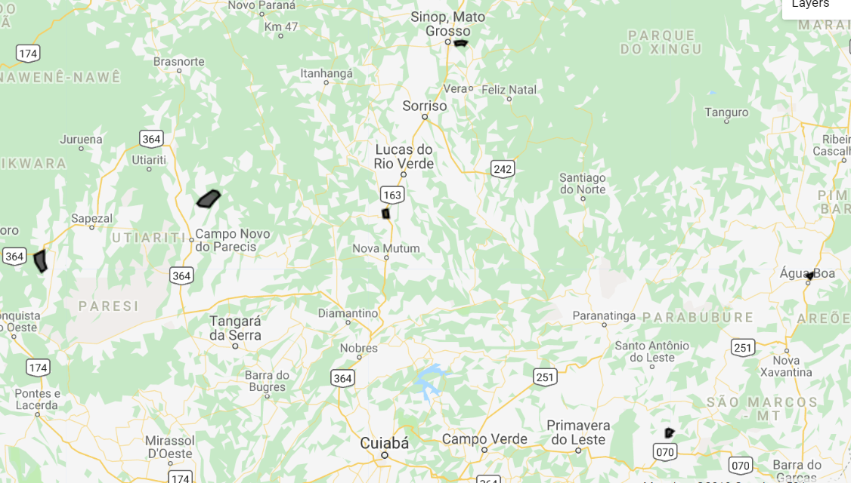
New MT location to download Planet
The locations of these polys are based on on soy_pts_agsat1, so only download for 2016-2017. Try to go for about 30 to 40 fields in different locations instead of 80 fields in a single location because of potential bias due to cloudy days
In MT, look at a place with SC (based on agsat training) and download for a place with known SC – useful for seeing accuracy of classifying SC
Download all of these in for 2016- 2017
Order of priority: poly 11 (has SC), poly 12, poly 14, poly 13, poly 15
Poly 12
Poly 5
Poly 15
Poly 13
Poly 14
Poly 11 (has SC)
Poly11 was ordered and downloaded on April 4.

Slide 4
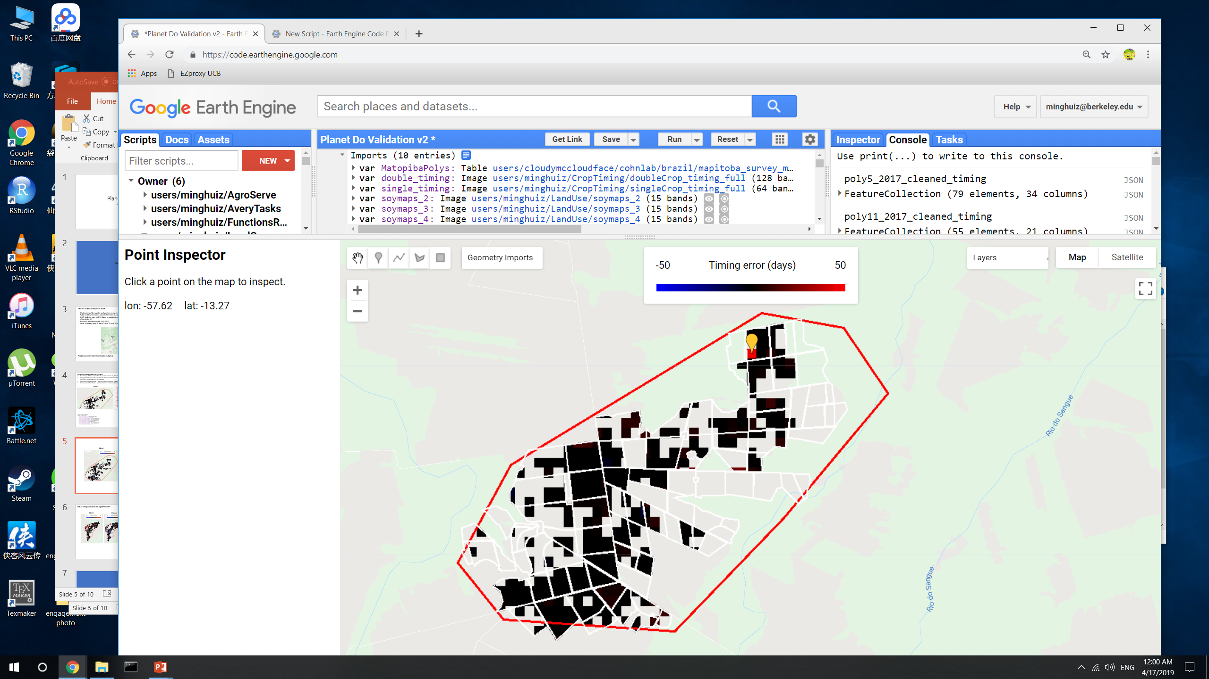
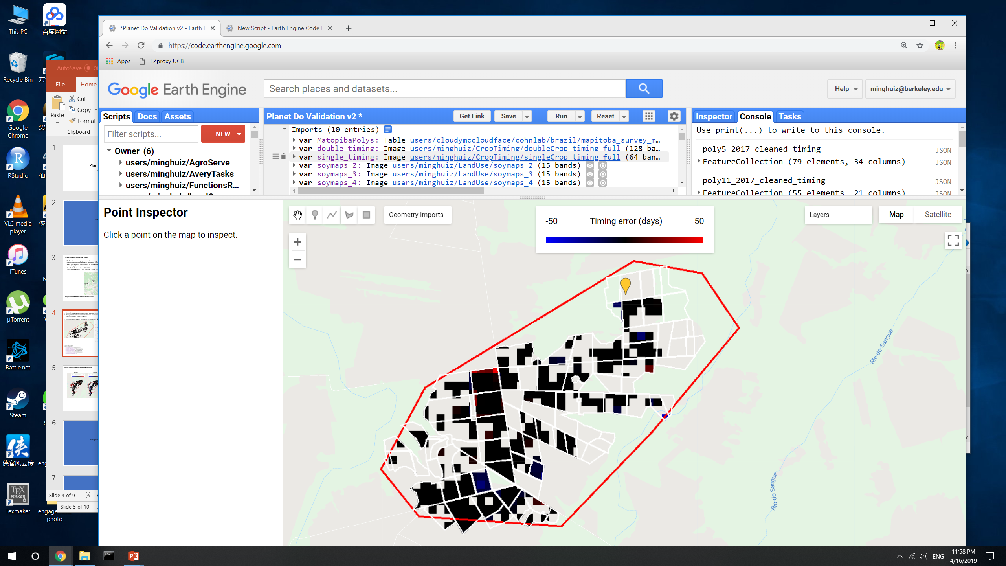
Poly5 timing validation and algorithm check
Plant1
Harvest 1

Slide 5
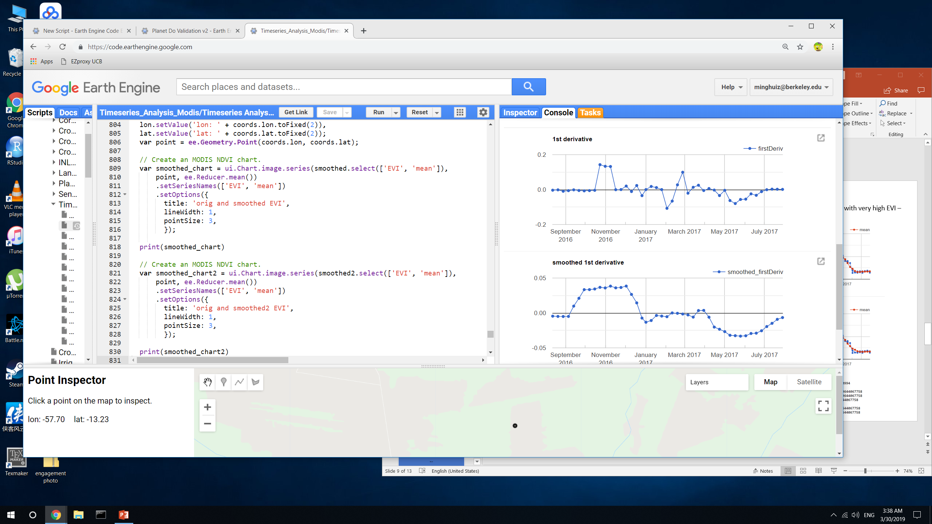
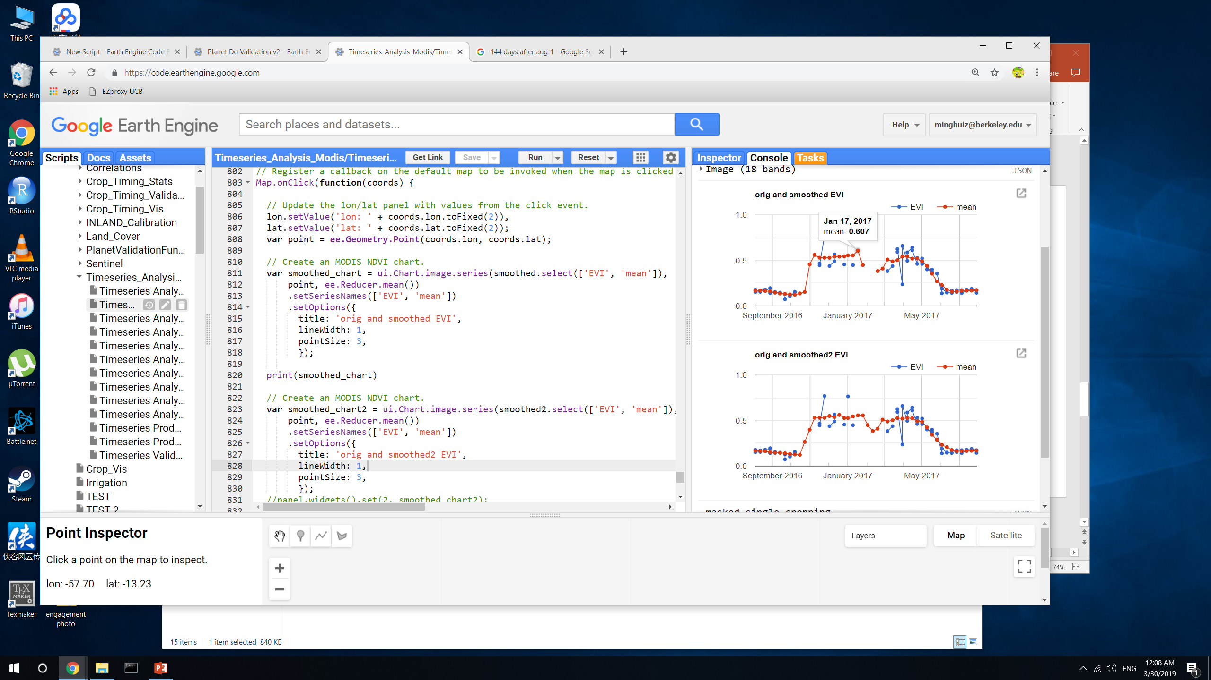
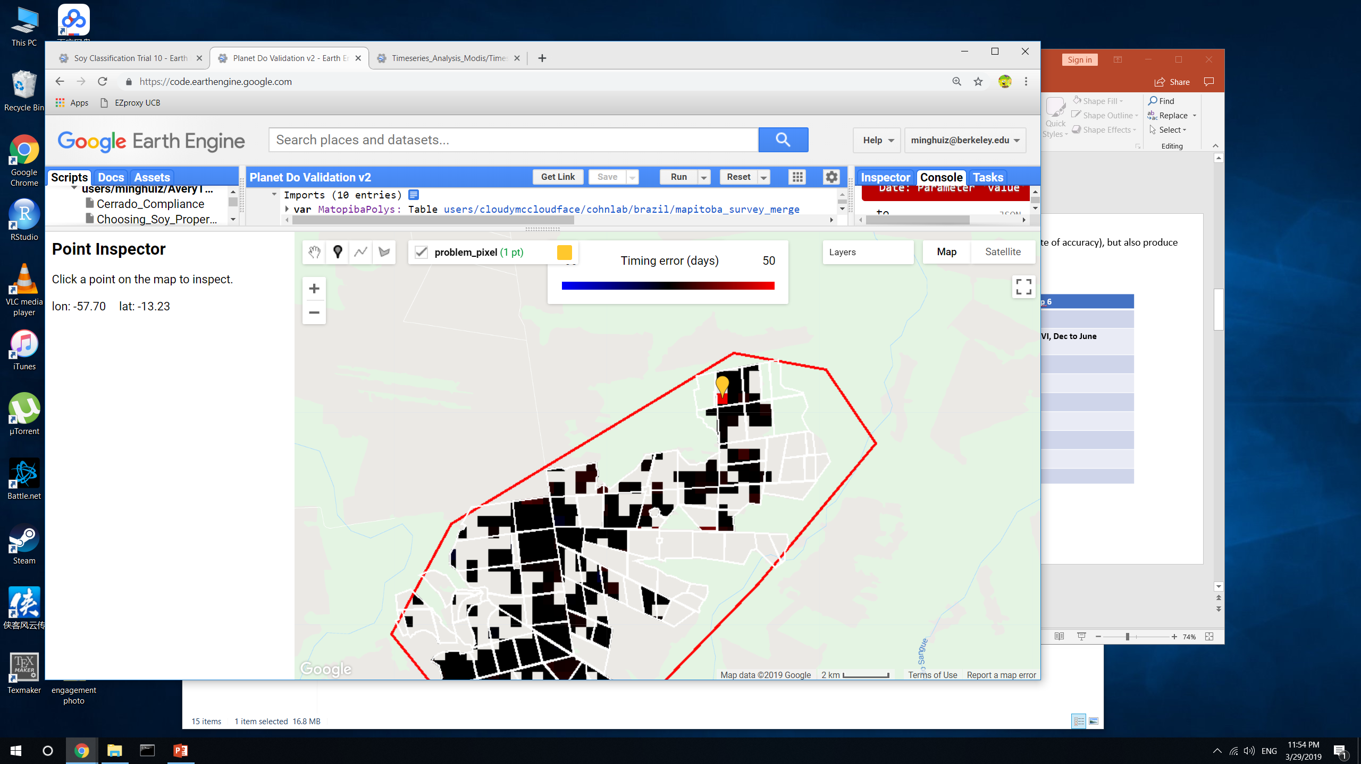
Poly5 Plant 1 error
Estimated plant 1 is very late
If we mask so that the lowest allowable quarter period is 20, this error wouldn’t be seen in final map.
The algorithm doesn’t work well when the timeseries looks essentially like a step function and there are random days with very high EVI – the location of the maximum is unstable because it’s really flat
The reason that the peak is at a strange location: maybe the qualityMosaic() function doesn’t distinguish well among similar EVIs
The reason that the inflection point is so late: the first derivative was so smoothed that the ‘maximum’ happened much later than it actually did
Plant1
Estimated:
Peak day = Jan 8
Infl1 day = Dec 23
Quarter period = 16
GEE file: Planet Do Validation v2, Timeseries Analysis v10

Slide 6
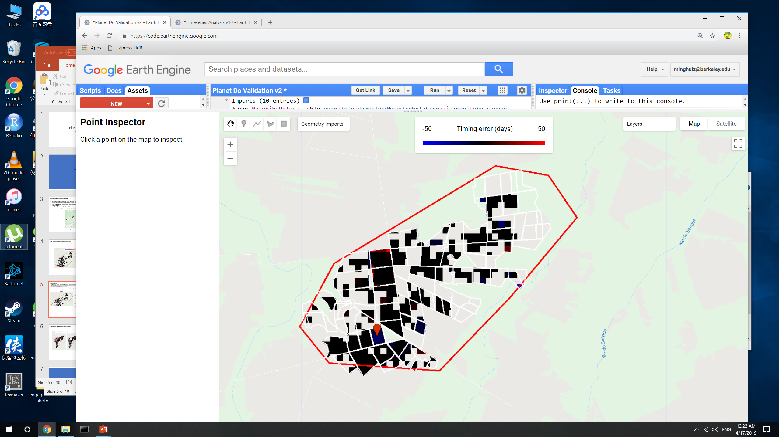
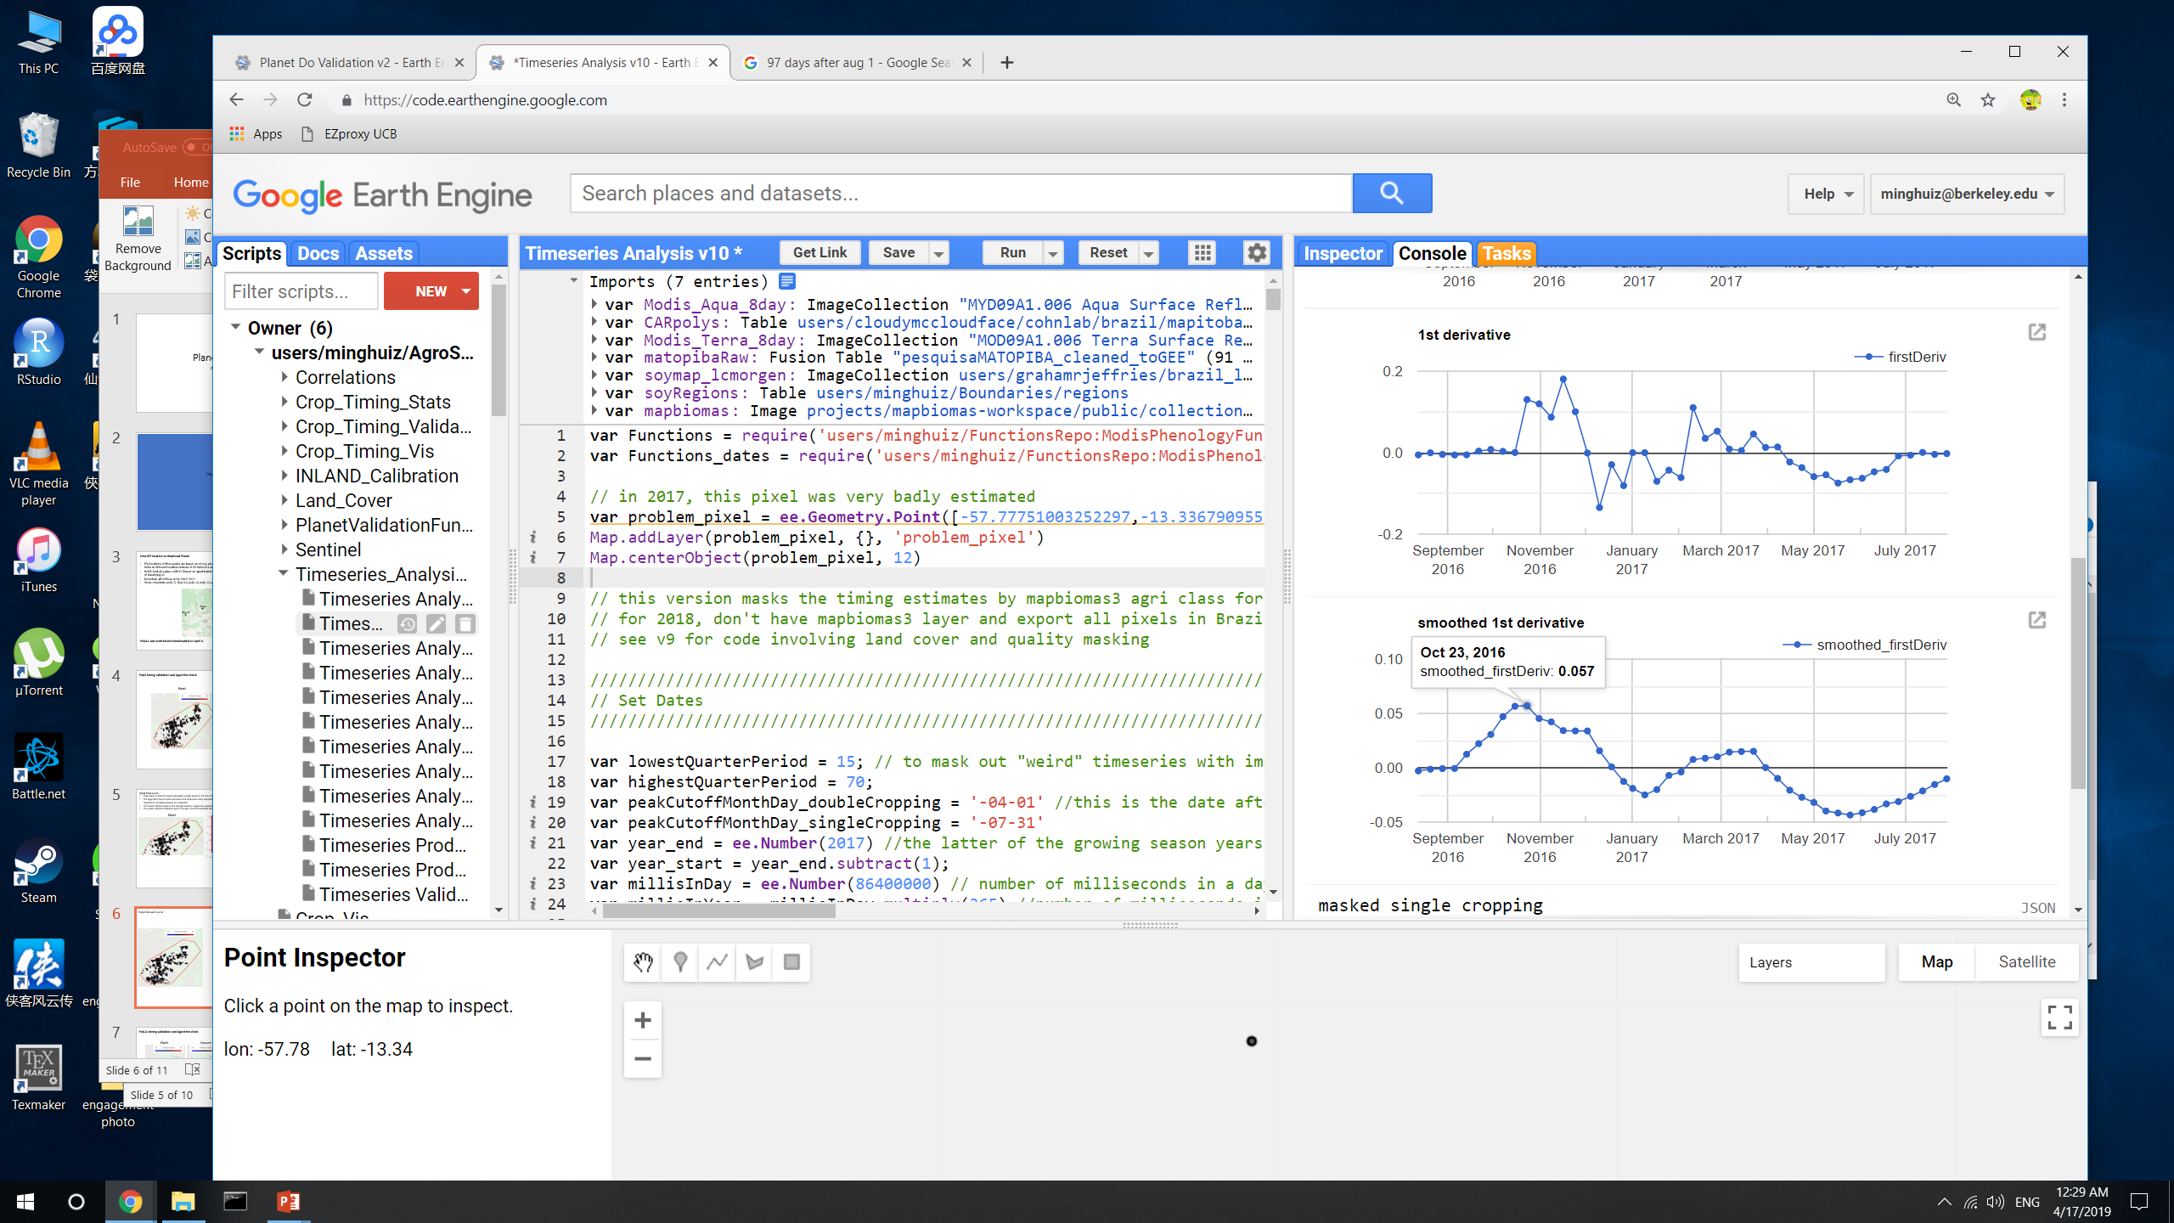
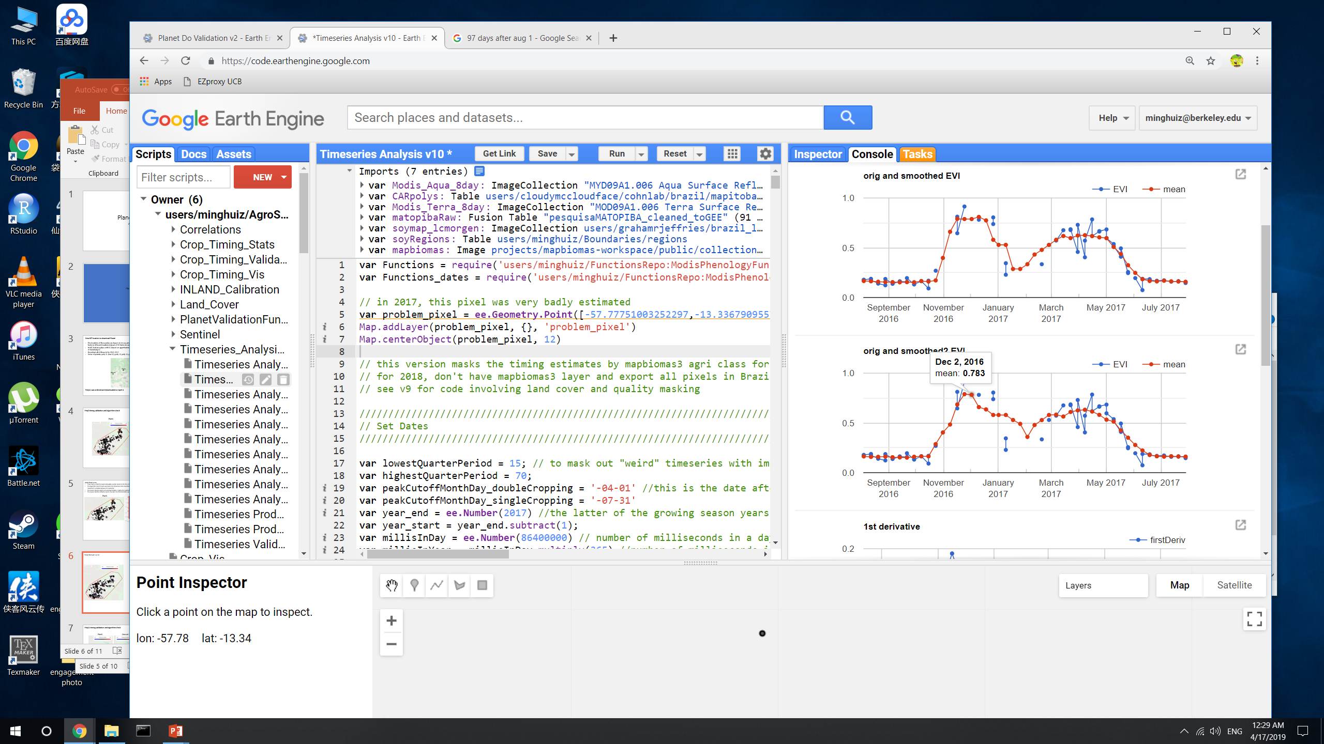
Poly5 Harvest 1 error
Estimated harvest was a month too early
There seems to be an asymmetry in the shape of the timeseries that causes estimated harvest to be so early – the rising limb rises very quickly, making the quarter period shorter than it really is
Estimated:
Peak day = Dec 8
Infl1 day = Nov 6
Quarter period = 32
GEE file: Planet Do Validation v2, Timeseries Analysis v10

Slide 7
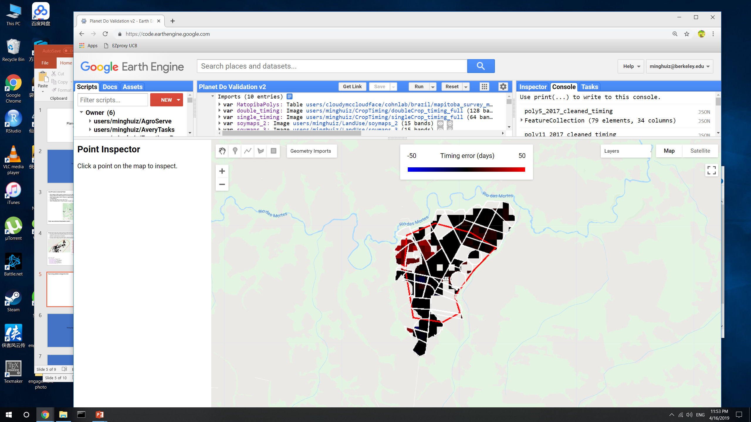
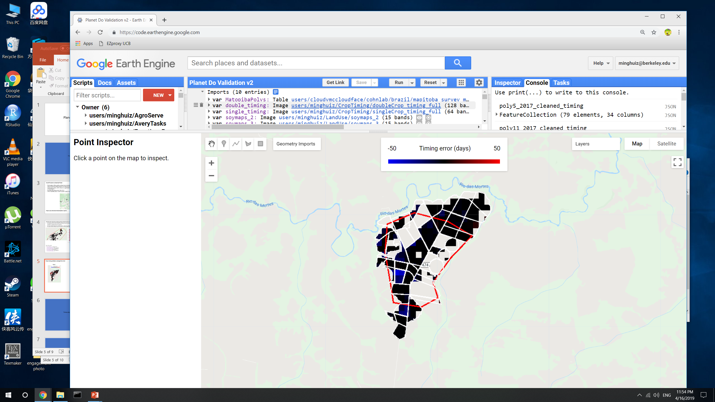
Poly11 timing validation and algorithm check
Plant1
Harvest 1
GEE file: Planet Do Validation v2, Timeseries Analysis v10

Slide 8
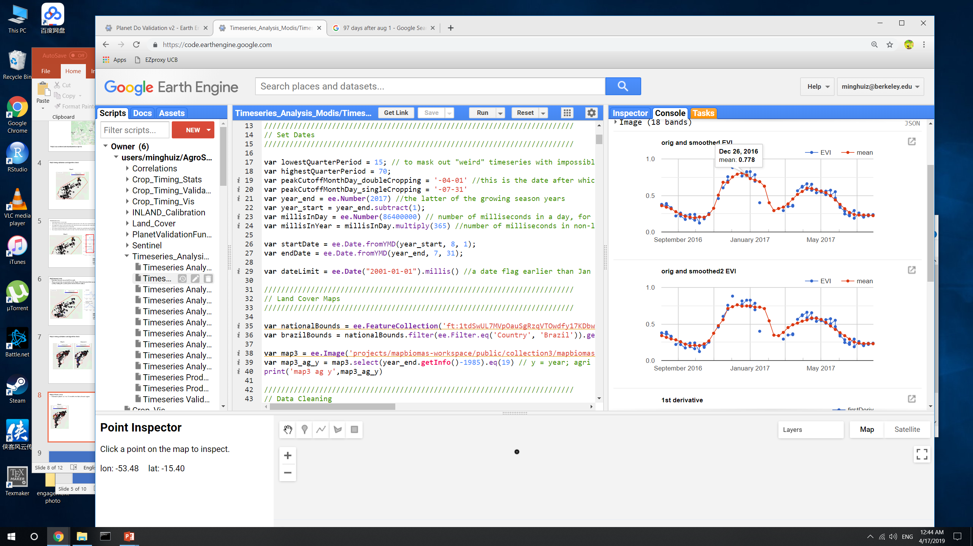
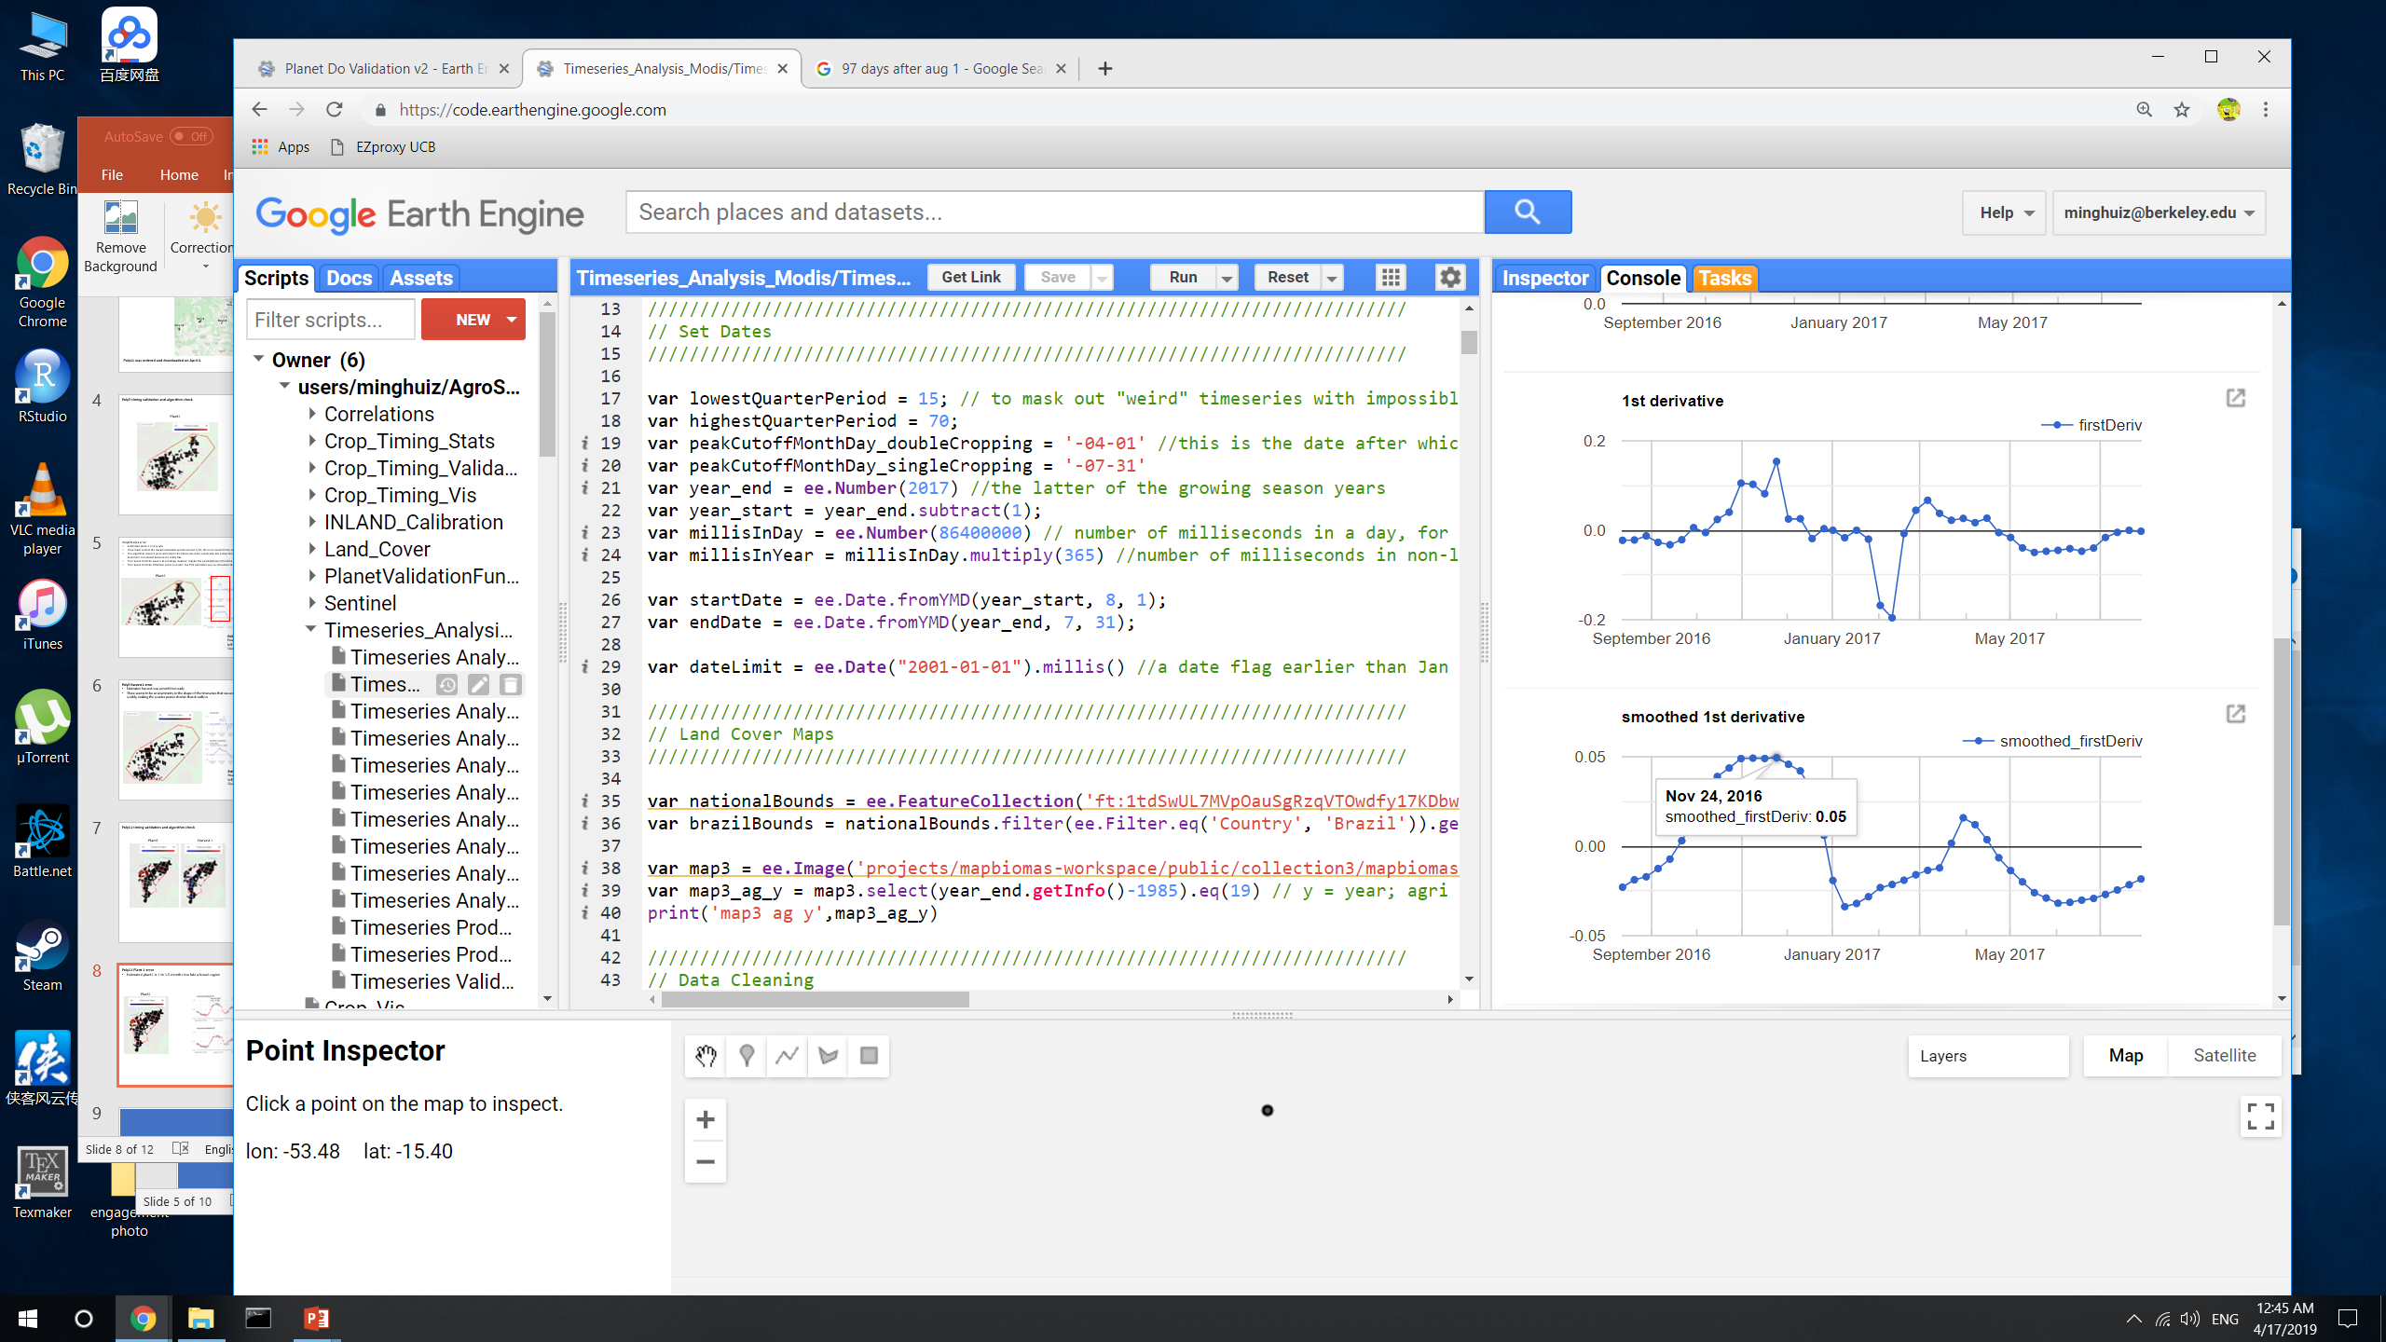
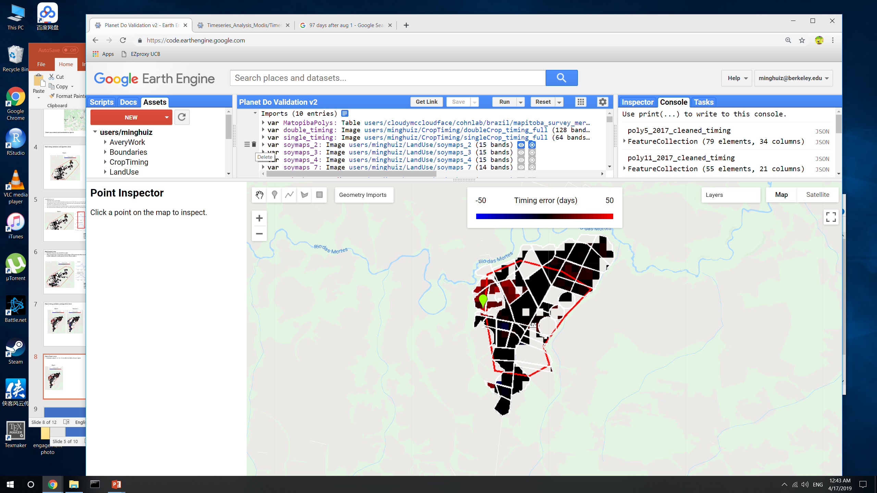
Poly11 Plant 1 error
Estimated plant1 is 1 to 1.5 months too late over a broad region
This could have been eliminated using 20 instead of 15 as the lowest allowable quarter period
The estimated peak was on the early side and the estimated inflection point was on the late side. Just a product of noise in EVI timeseries.
Plant1
Estimated:
Peak day = Dec 13
Infl1 day = Nov 27
Quarter period = 16
GEE file: Planet Do Validation v2, Timeseries Analysis v10

Slide 9
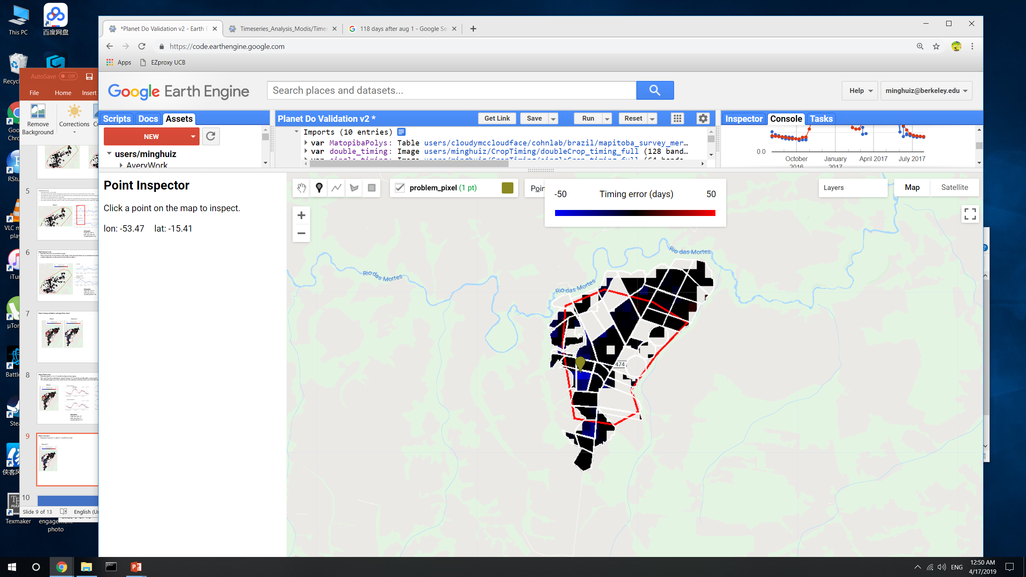
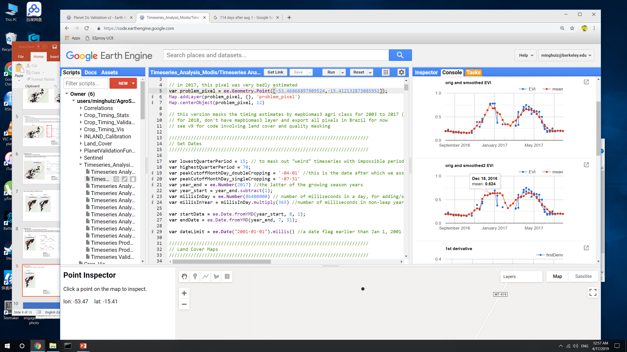

Poly11 Harvest 1
Estimated harvest 1 is about 1 month too early
The peak and inflection point look ok in this case; perhaps the equation for peak+greenup -> harvest isn’t right
Harvest 1
Estimated:
Peak day = Dec 17
Infl1 day = Nov 23
Quarter period = 24
GEE file: Planet Do Validation v2, Timeseries Analysis v10

Slide 10
Takeaways from pixel level timeseries validation
May need to adjust the timeseries analysis and calibration equation with sensitivity analysis, use the Planet derived validation data as the way to choose which one is best
Estimated planting tends to be late; estimated harvest tends to be early
Smoothing of the first derivative can shift inflection point too much
Smoothing in general, especially to find the peak EVI date, can be vulnerable to noise in the EVI; smoothing can create a flat top and the time of the peak might shift a lot due to noise in EVI
General noise in the EVI timeseries usually generates about 1 month of error

Slide 11
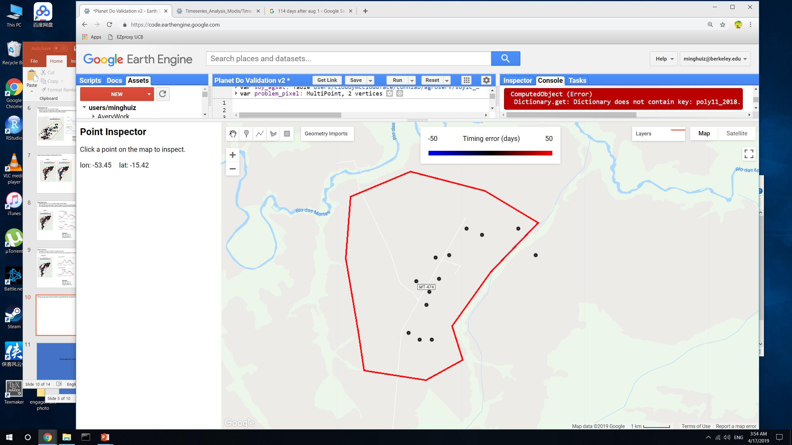
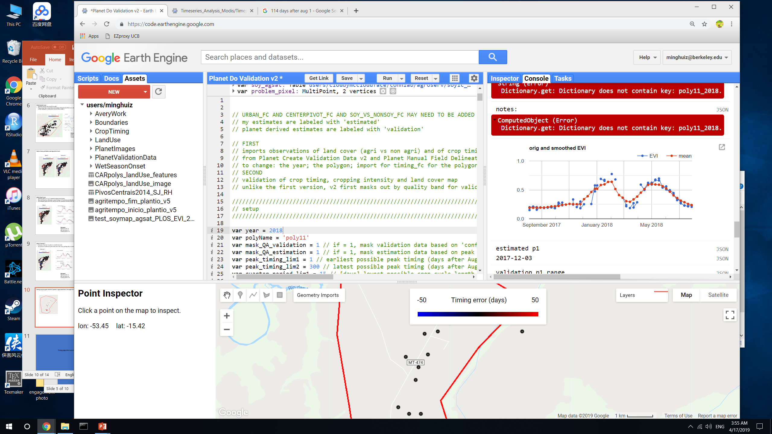
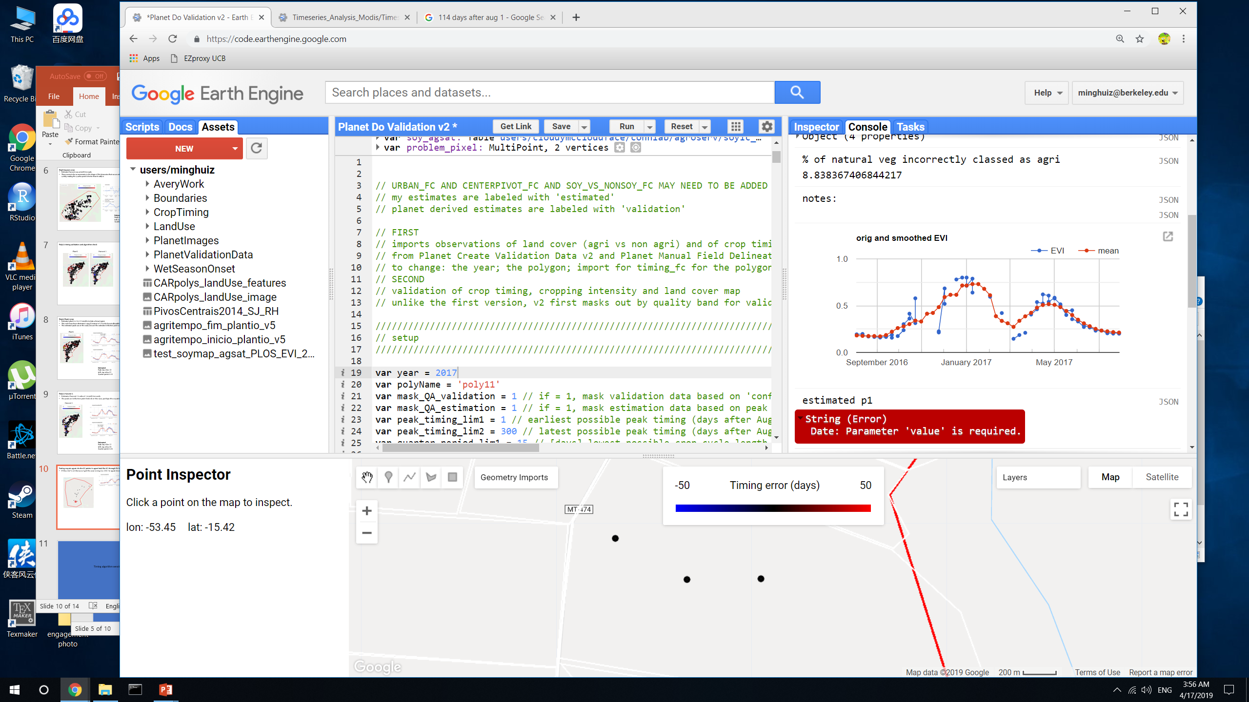
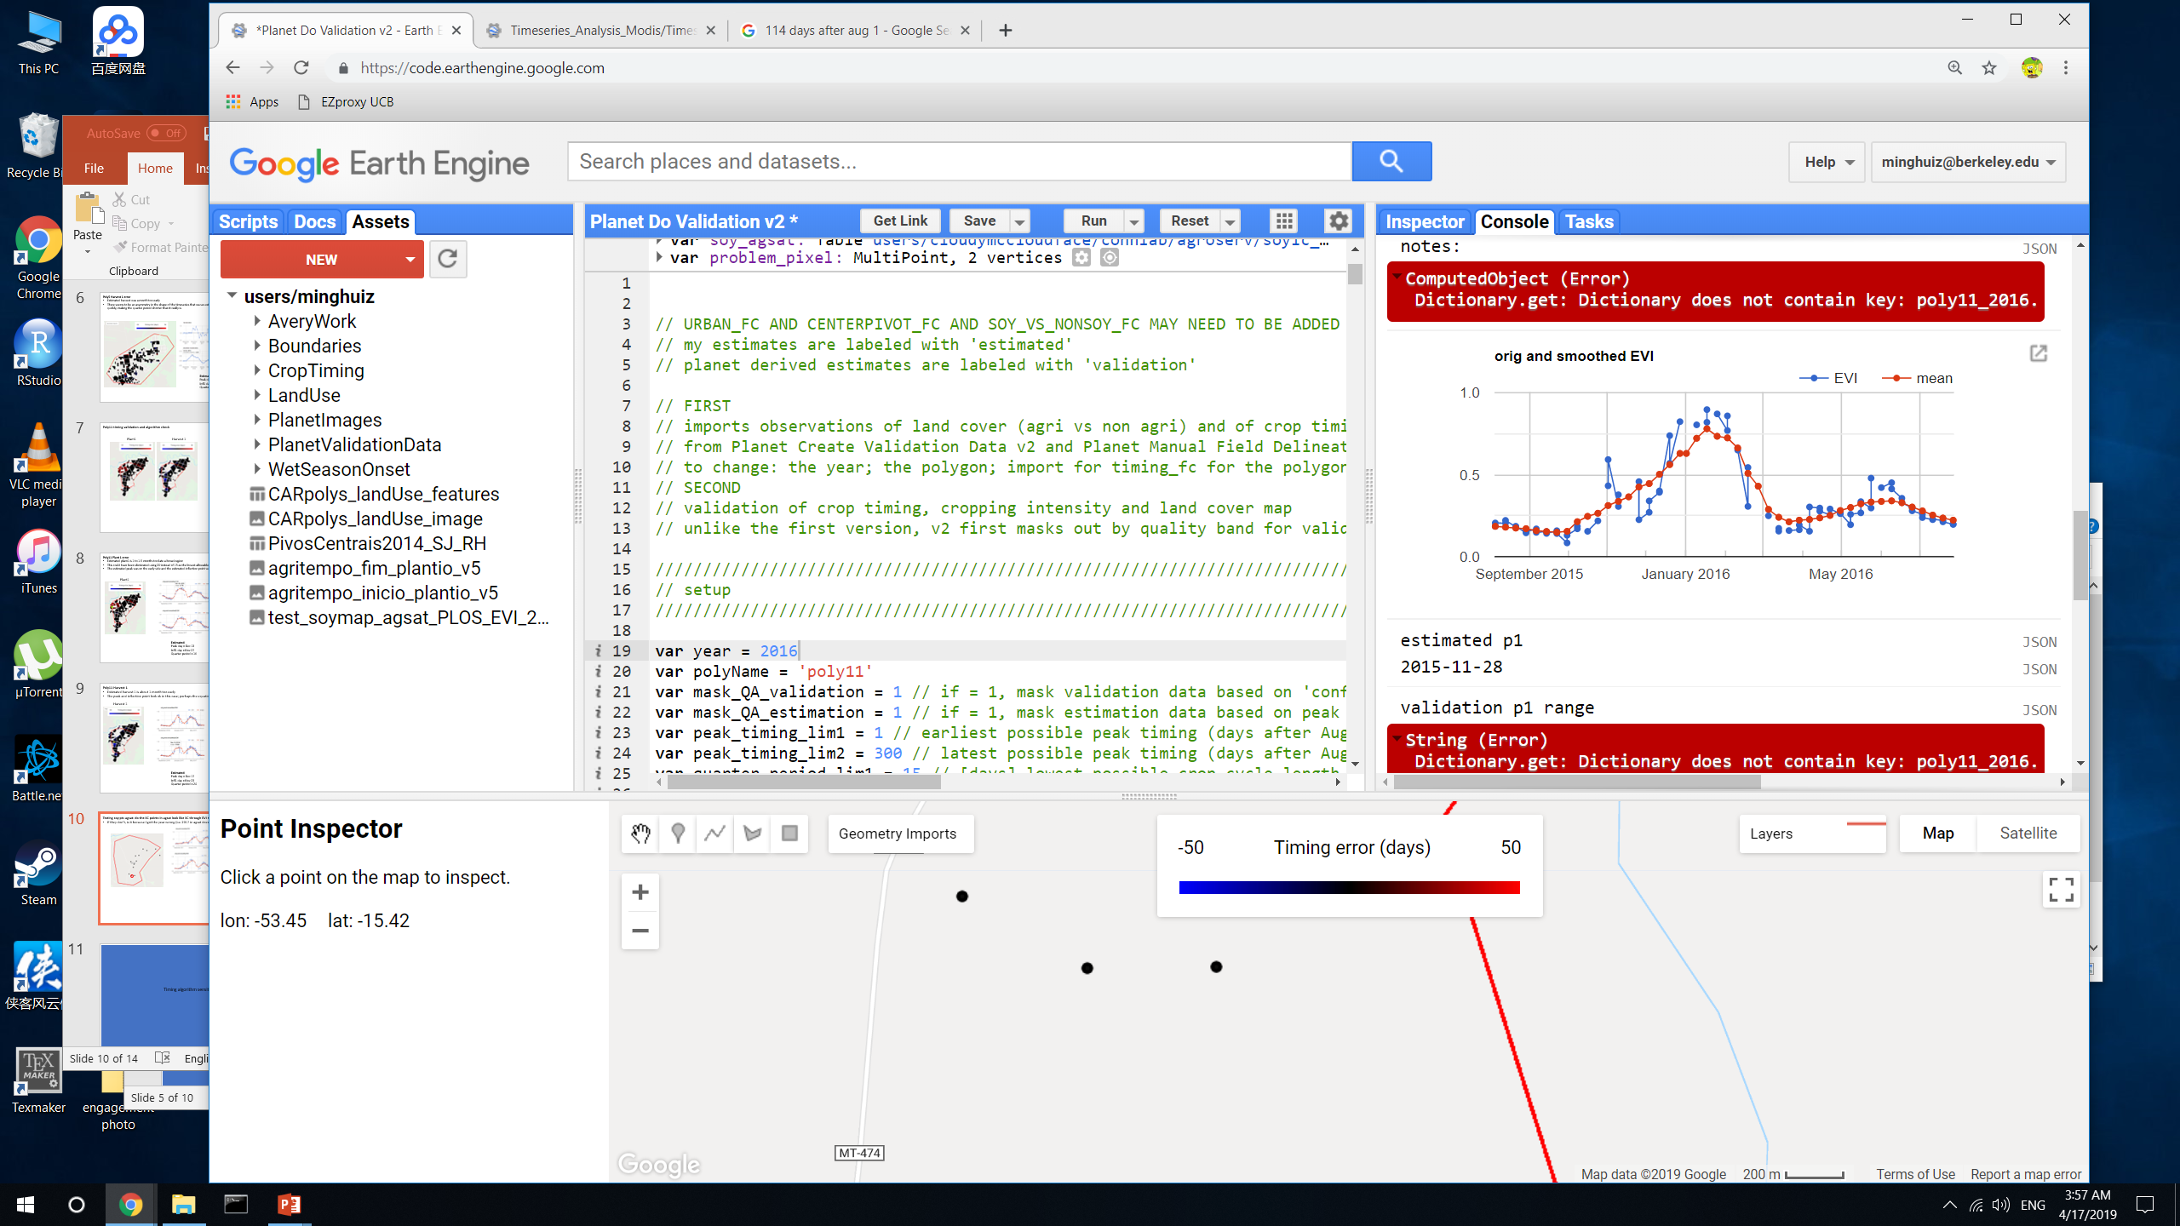
Testing soy pts agsat: do the SC points in agsat look like SC through EVI timeseries?
If they don’t, is it because I got the year wrong (i.e. 2017 in agsat doesn’t mean 2016 to 2017?)
No, changing the year from y-1 to y to y to y+1 doesn’t generate EVI timeseries that makes more sense
SC soy in 2017, according to agsat
GEE file: Planet Do Validation v2

Slide 12
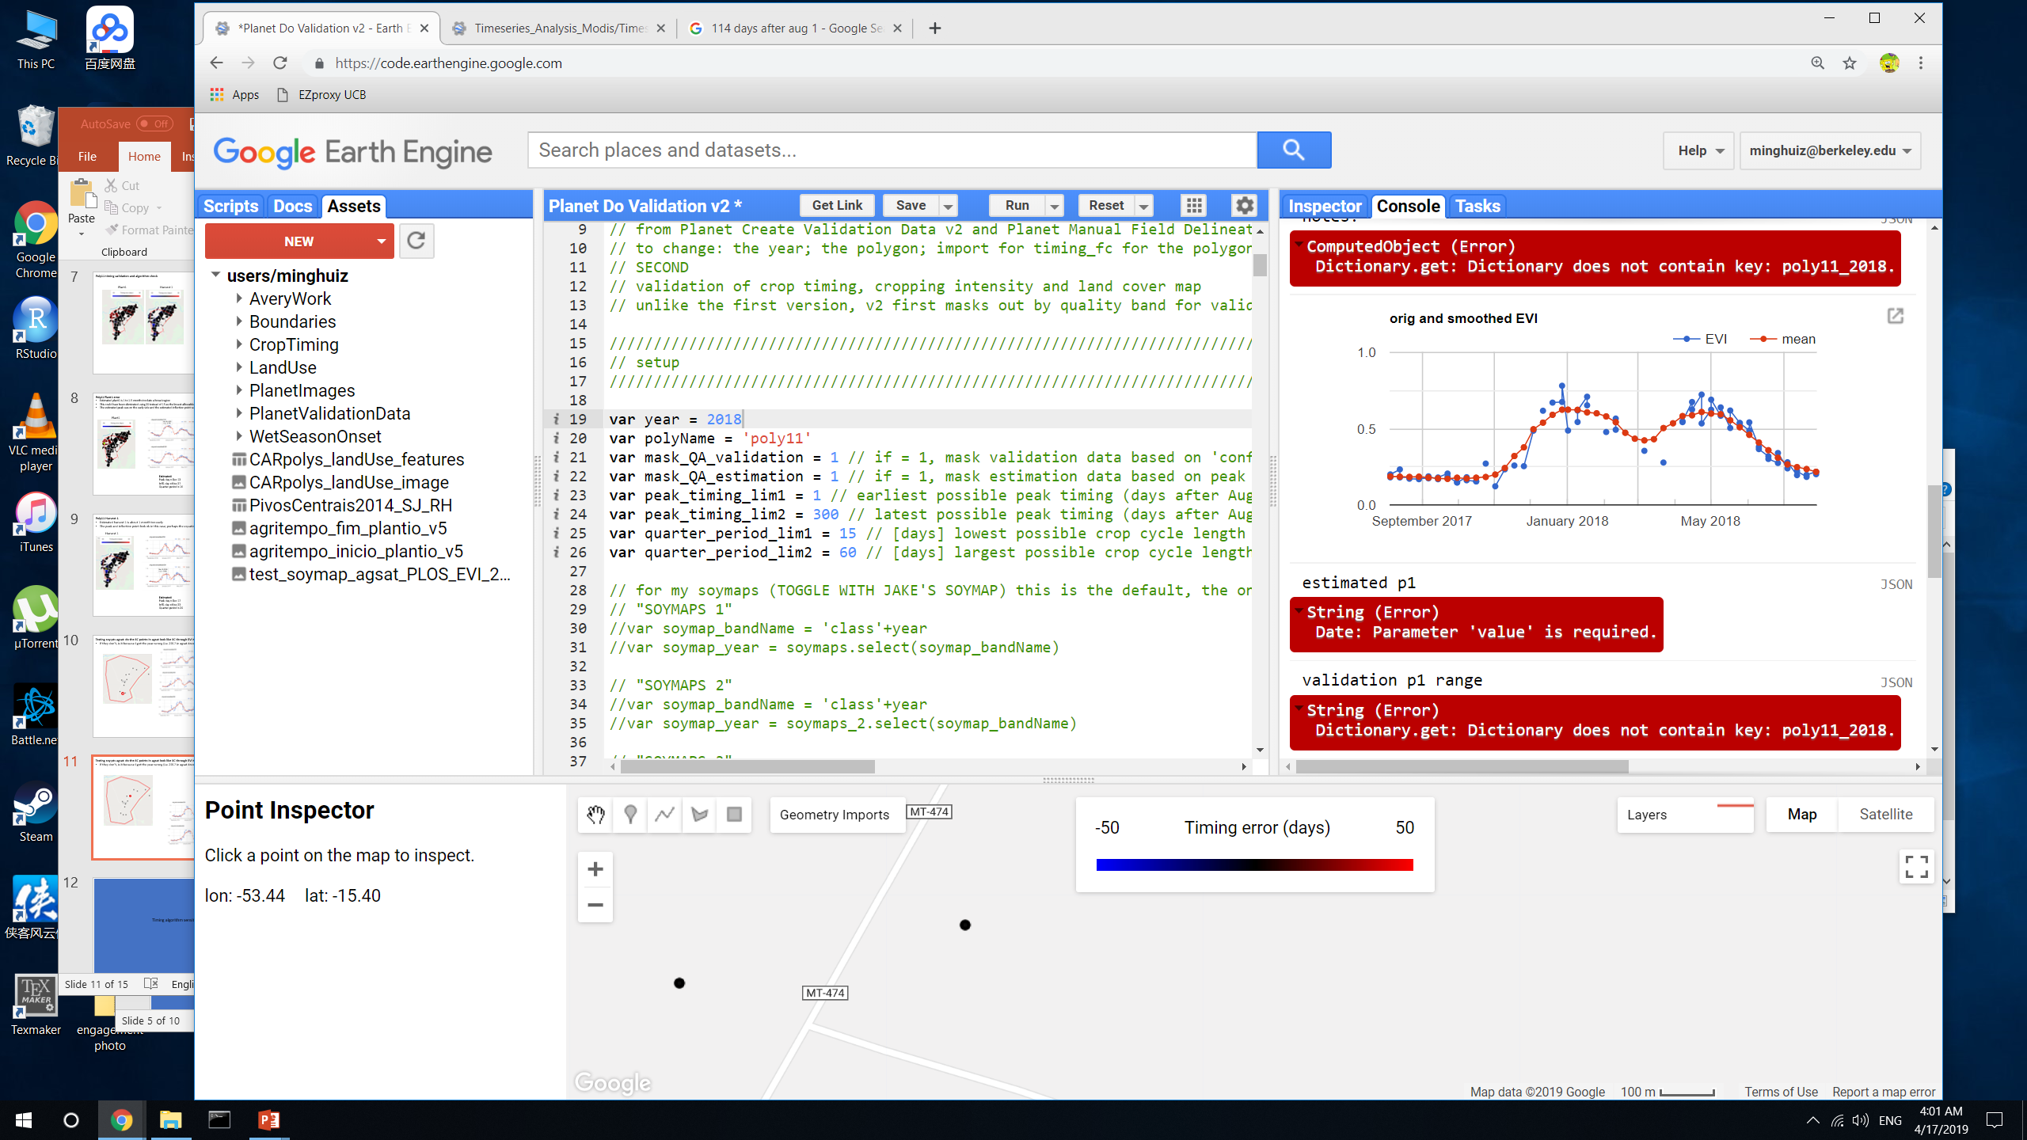
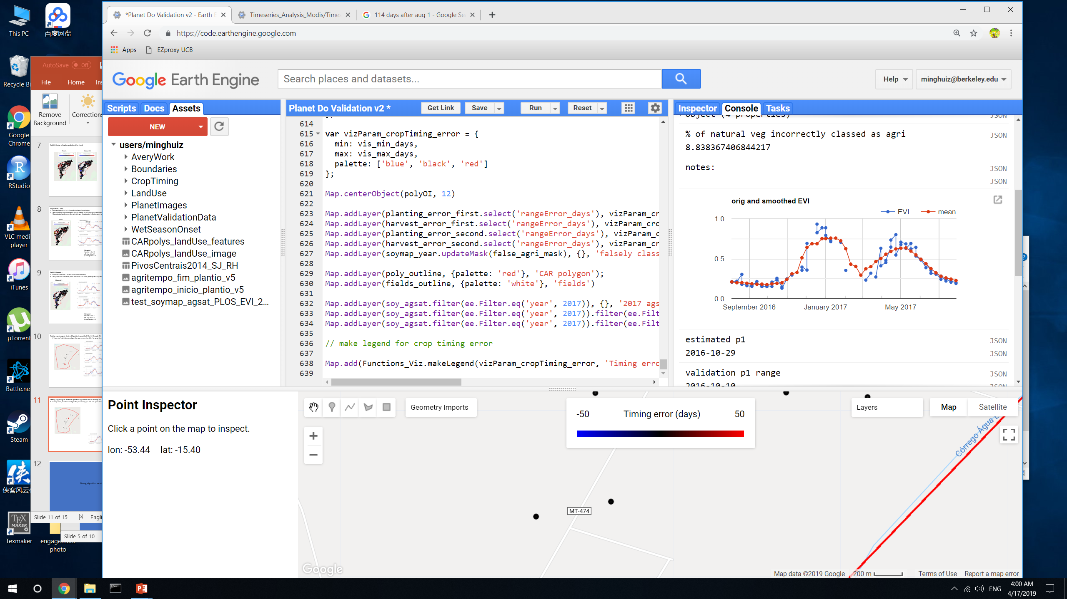
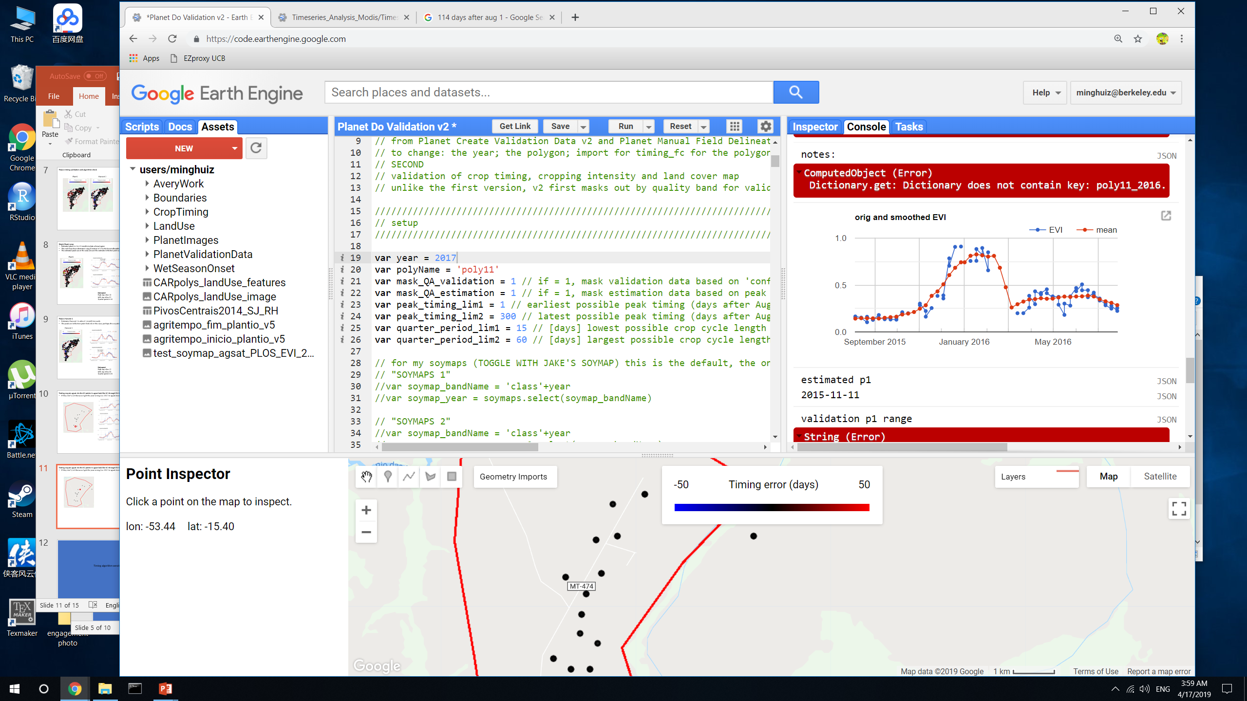
Testing soy pts agsat: do the SC points in agsat look like SC through EVI timeseries?
If they don’t, is it because I got the year wrong (i.e. 2017 in agsat doesn’t mean 2016 to 2017?)
SC soy in 2017, according to agsat
GEE file: Planet Do Validation v2

Slide 13
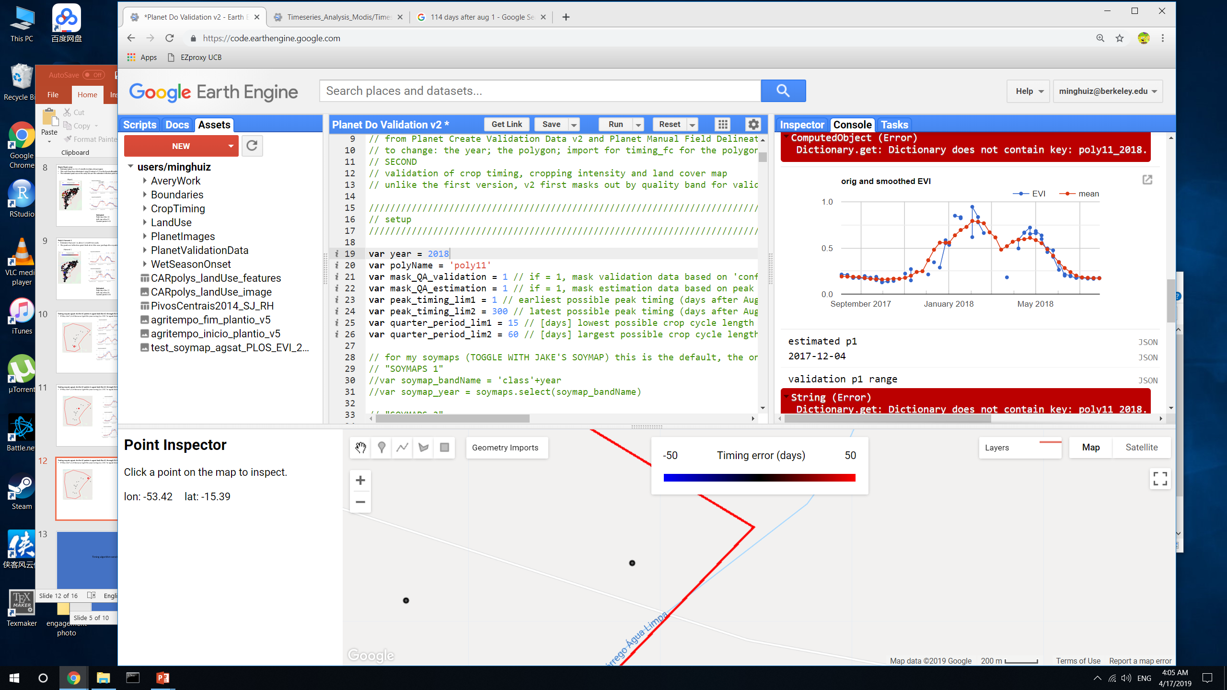
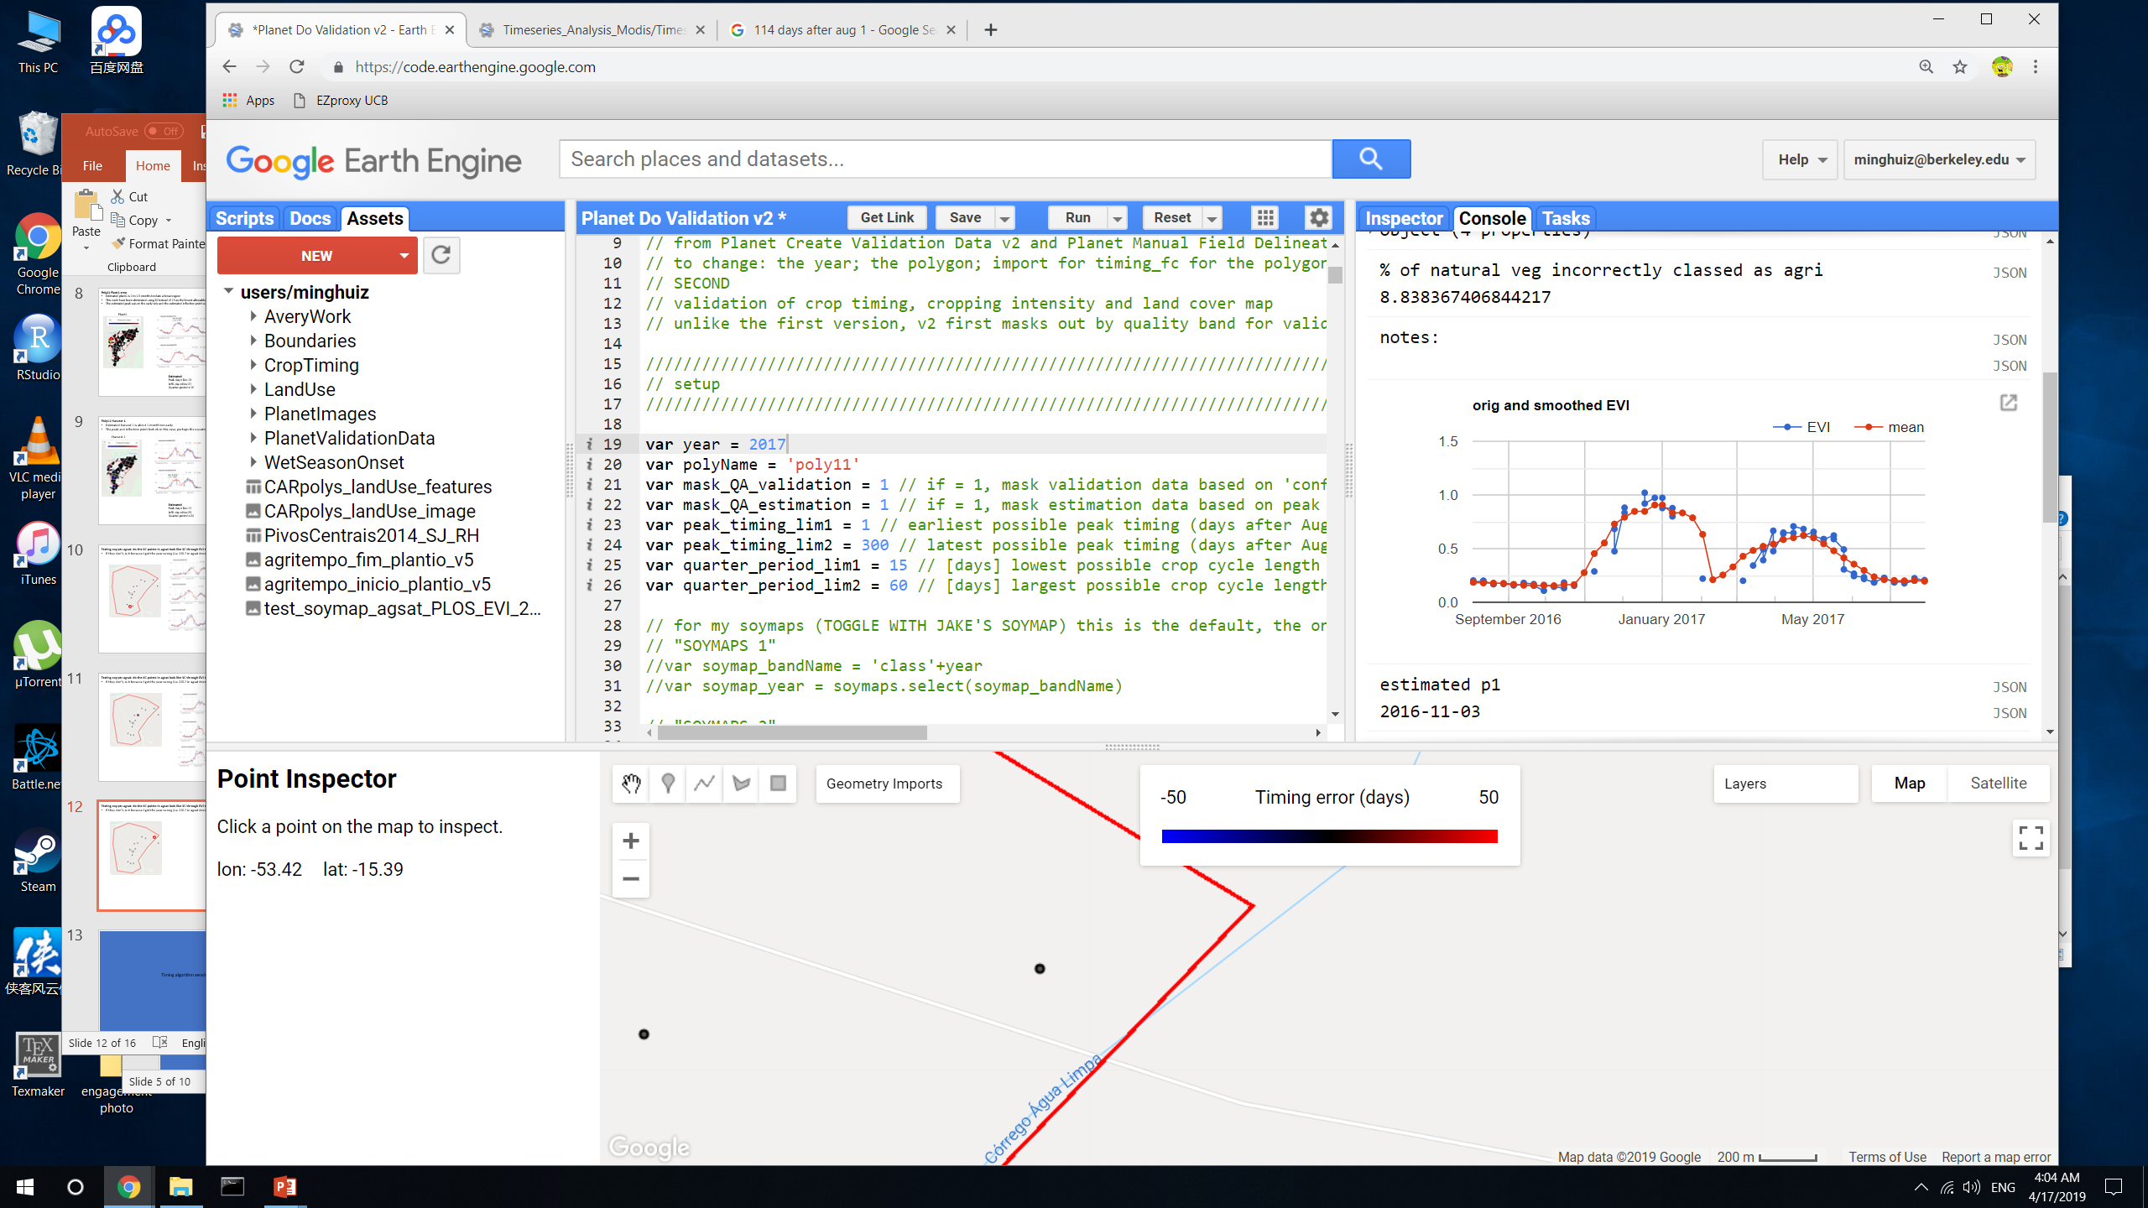
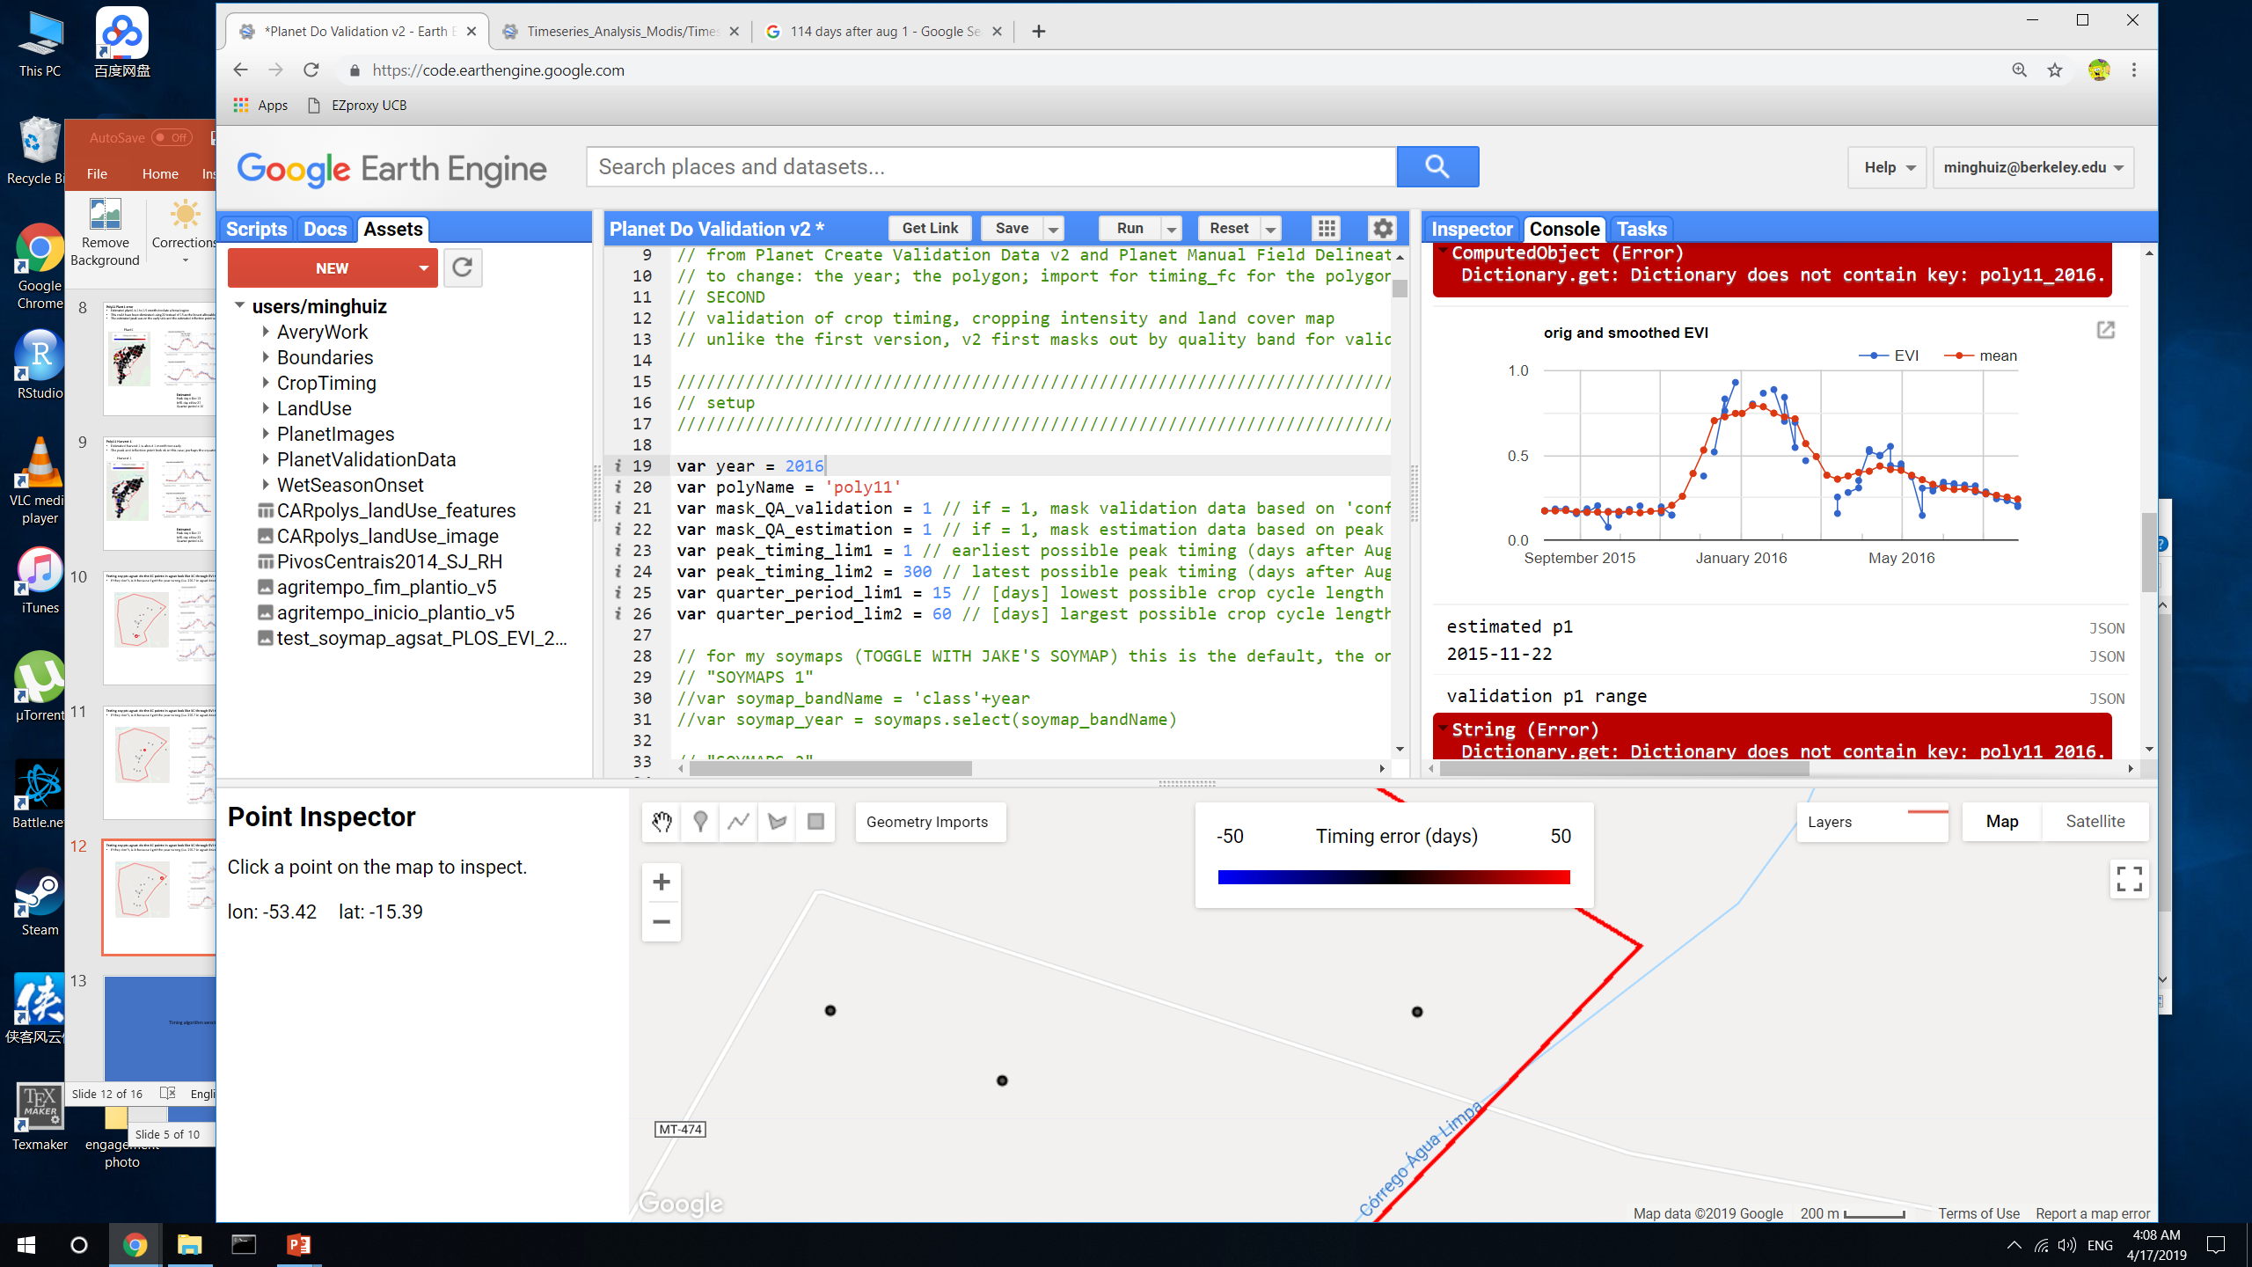
Testing soy pts agsat: do the SC points in agsat look like SC through EVI timeseries?
If they don’t, is it because I got the year wrong (i.e. 2017 in agsat doesn’t mean 2016 to 2017?)
SC soy in 2017, according to agsat
GEE file: Planet Do Validation v2

Slide 14
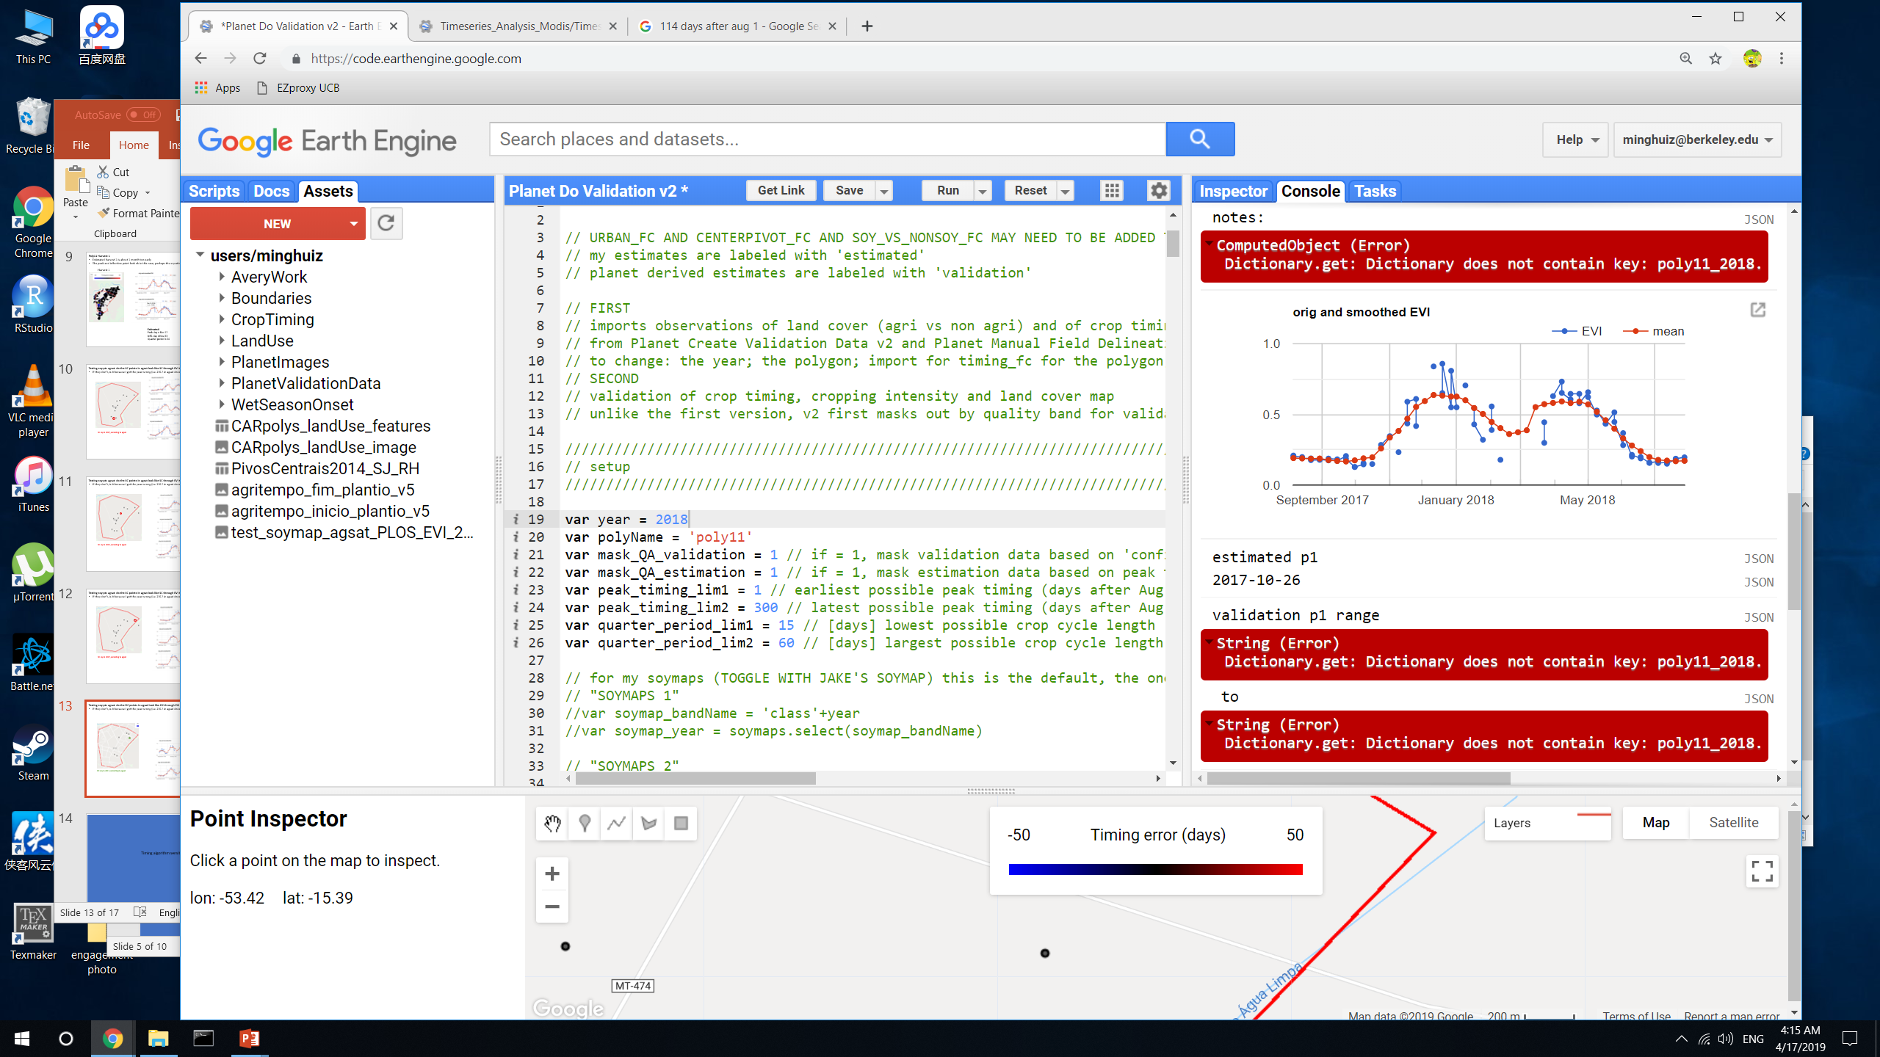
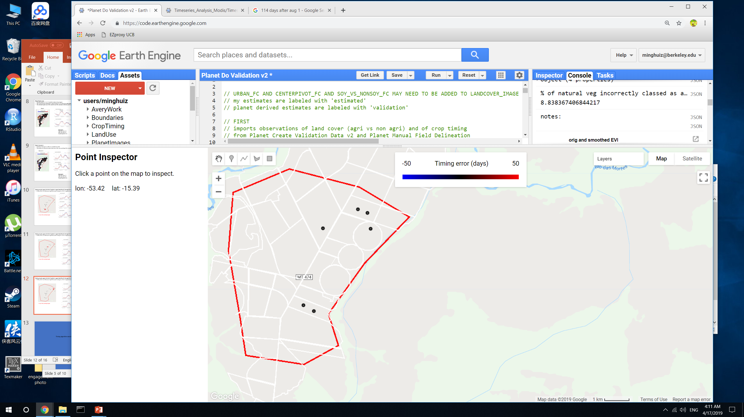
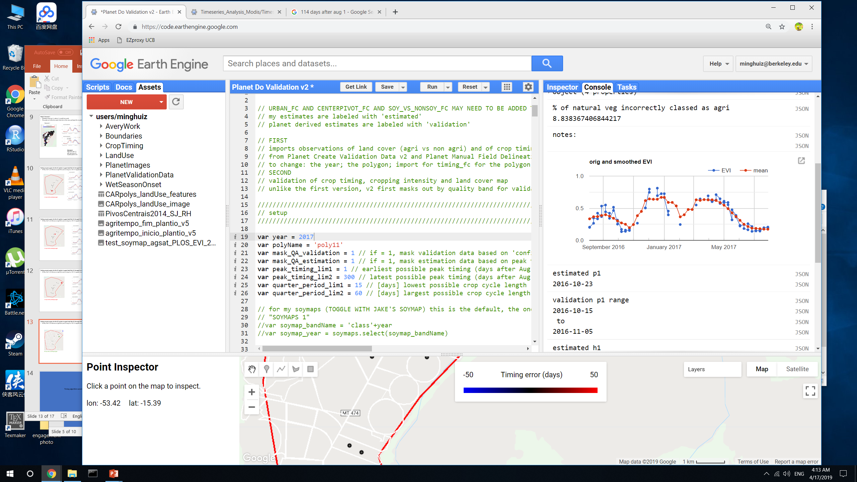
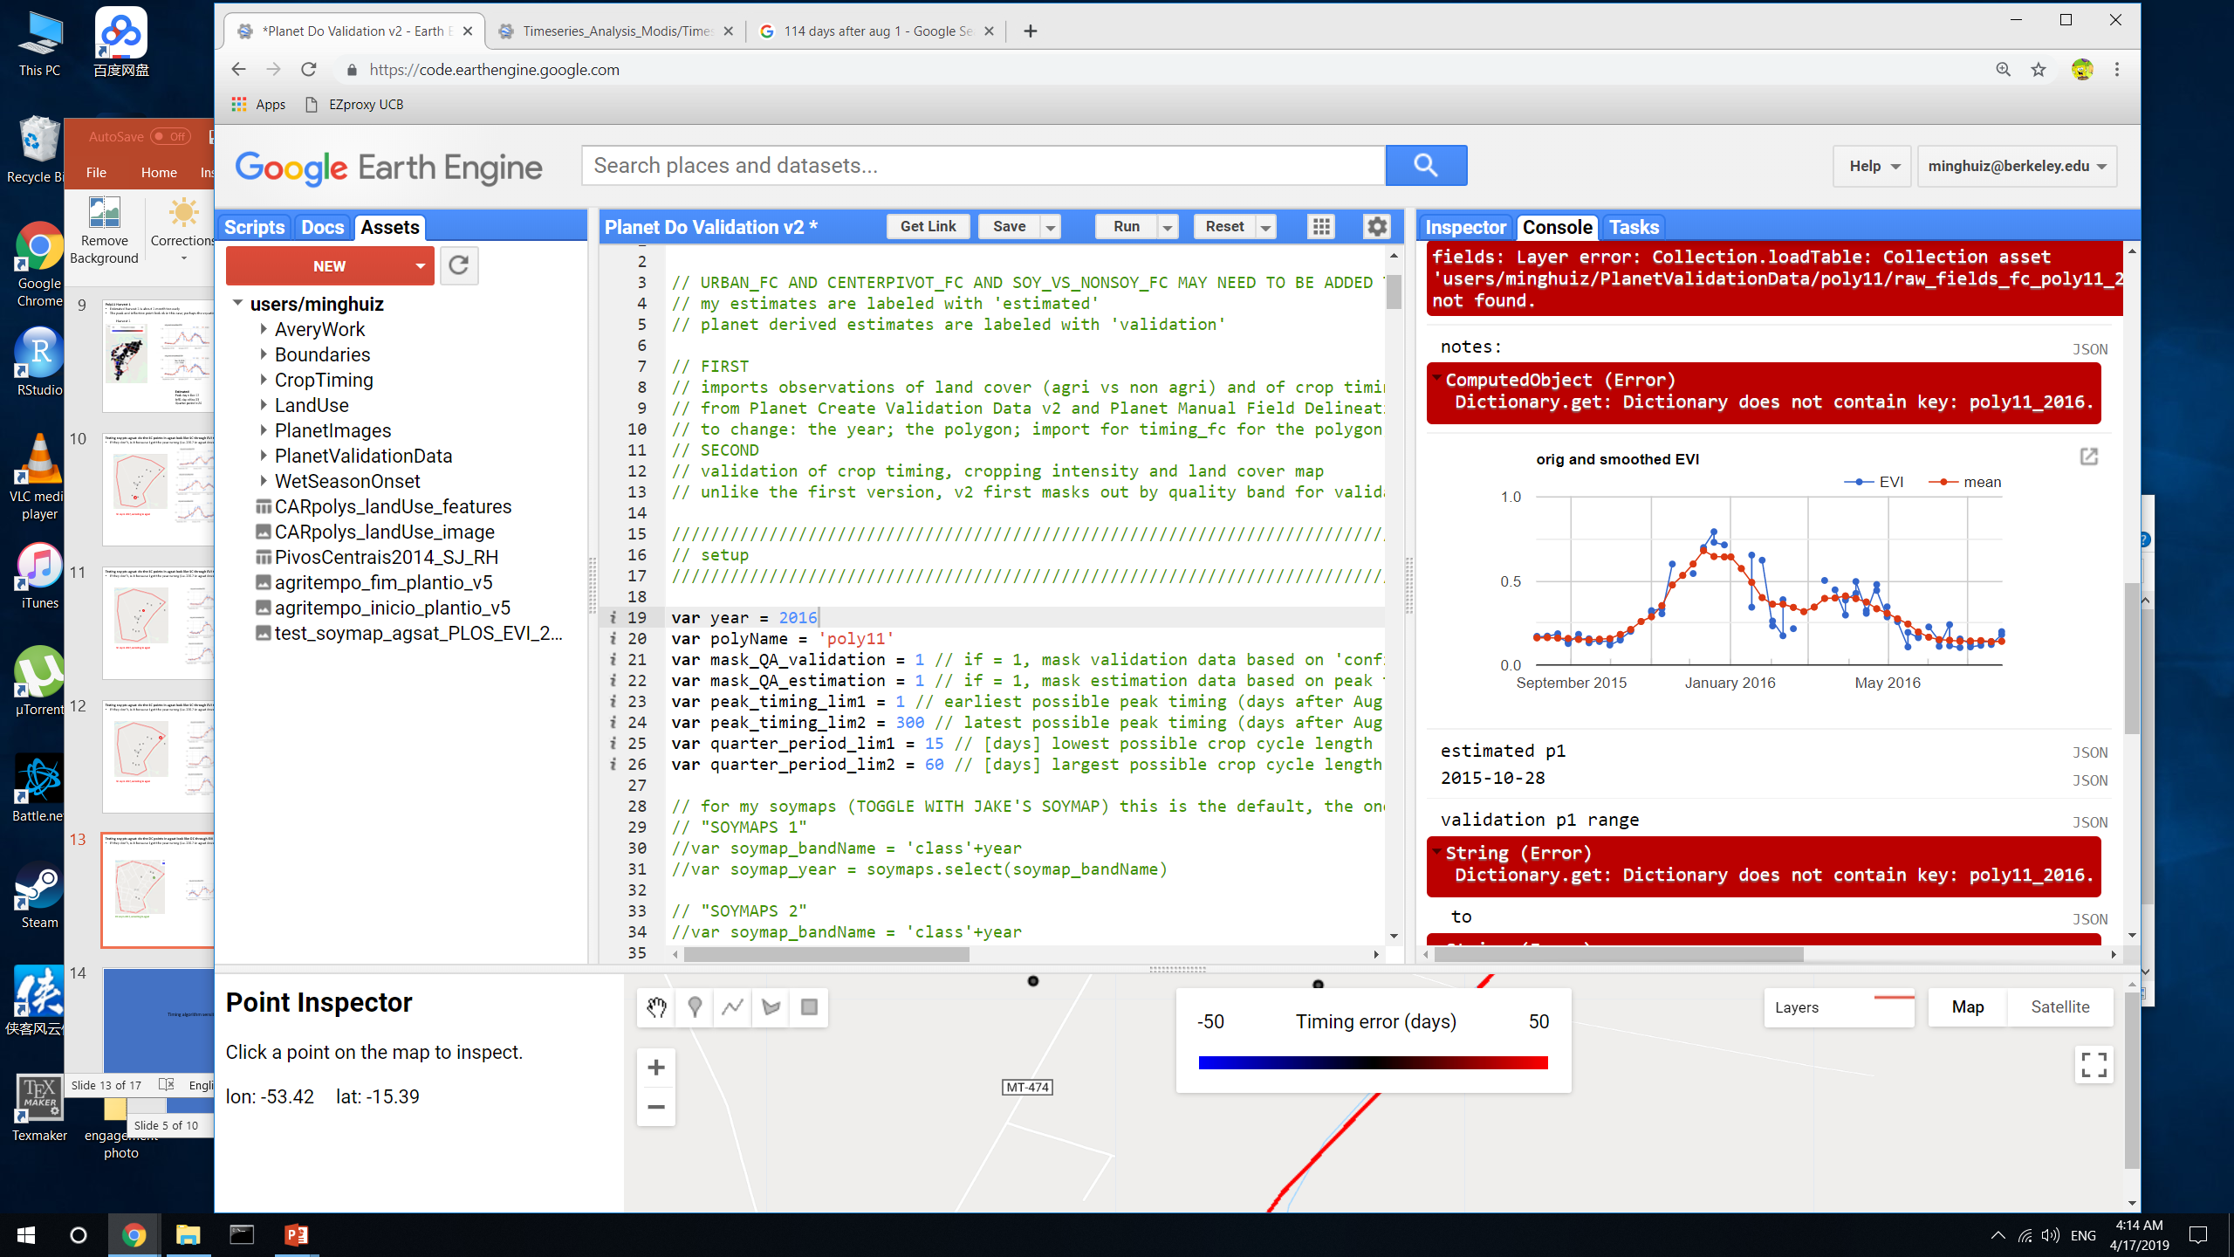
Testing soy pts agsat: do the DC points in agsat look like DC through EVI timeseries?
If they don’t, is it because I got the year wrong (i.e. 2017 in agsat doesn’t mean 2016 to 2017?)
DC soy in 2017, according to agsat
GEE file: Planet Do Validation v2

Slide 15
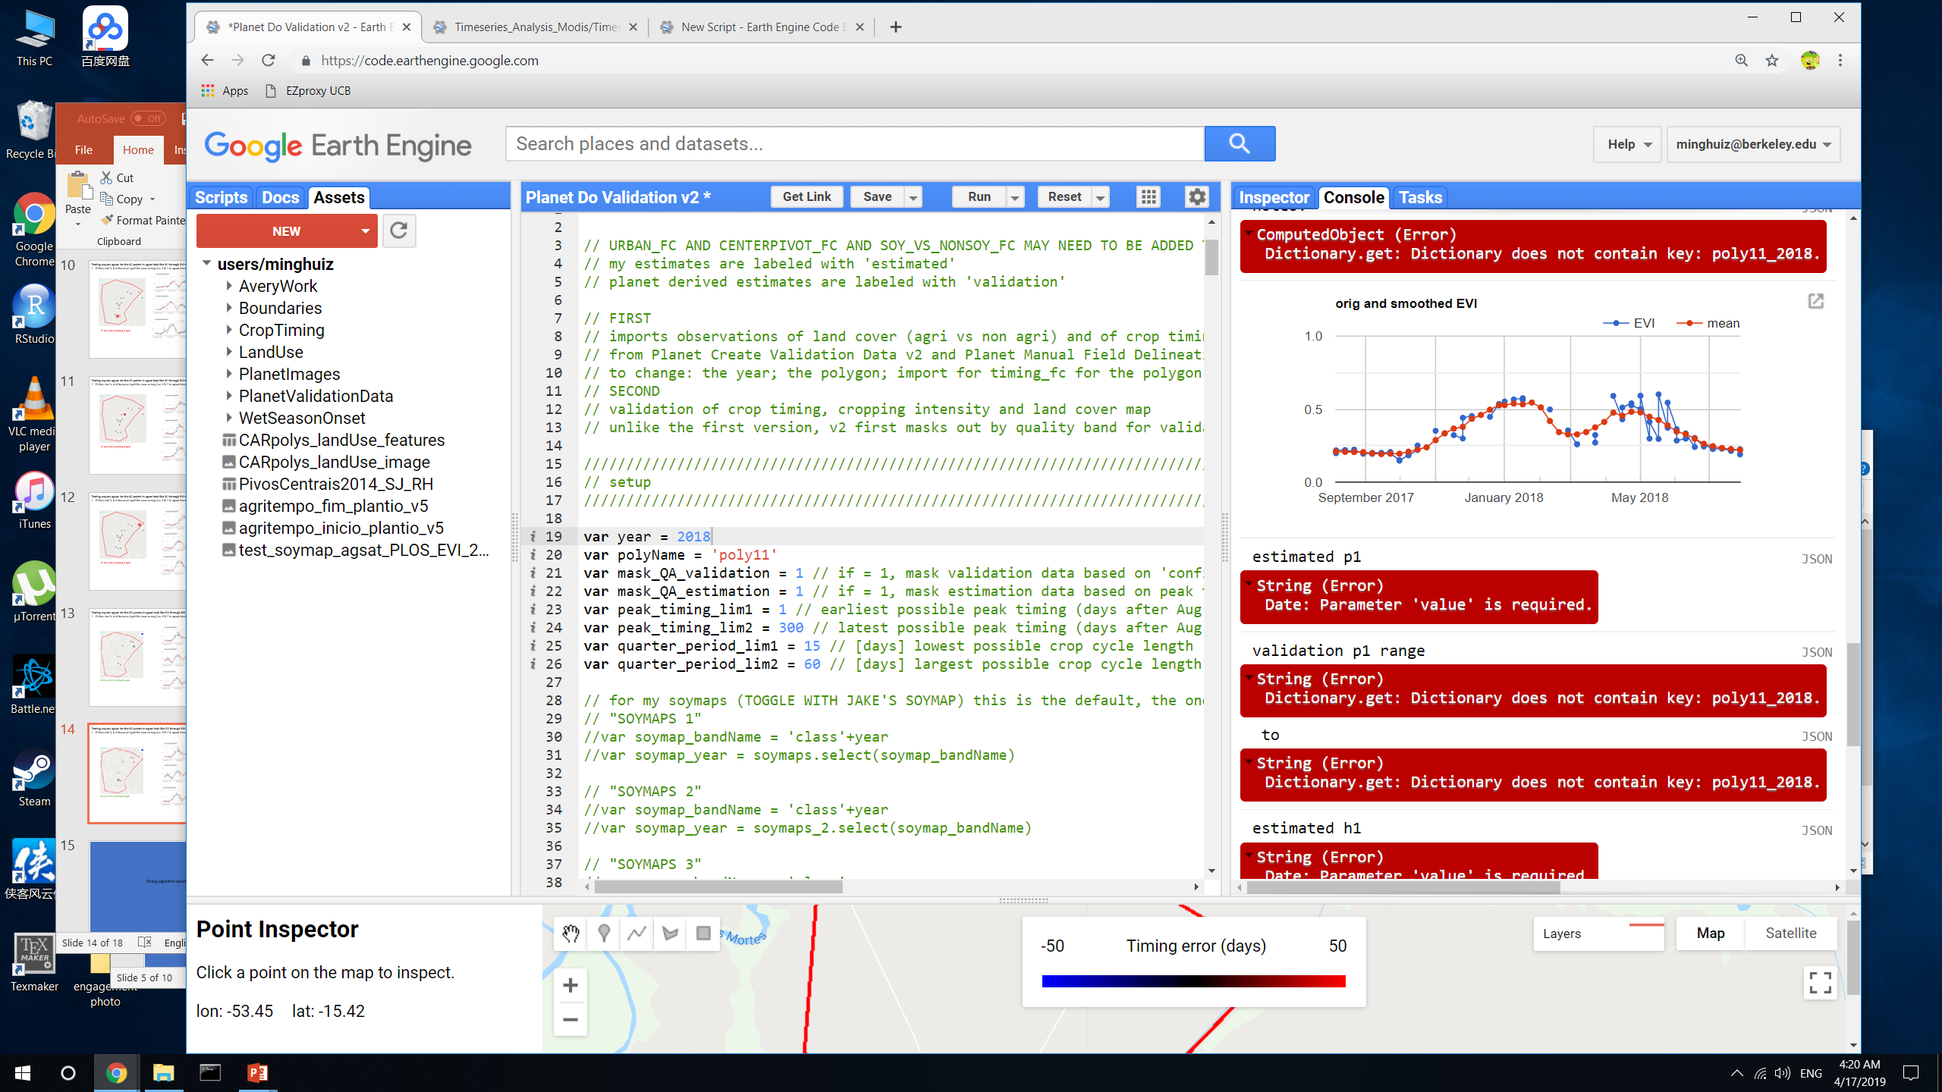
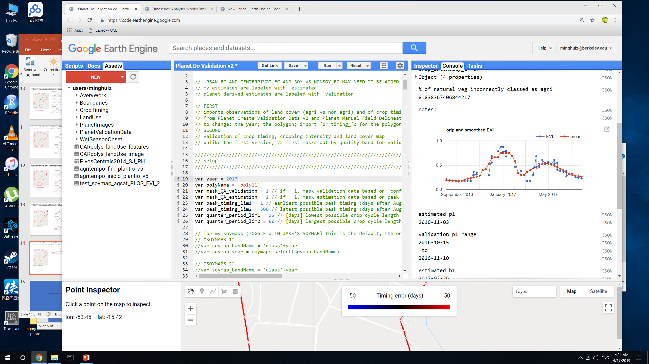
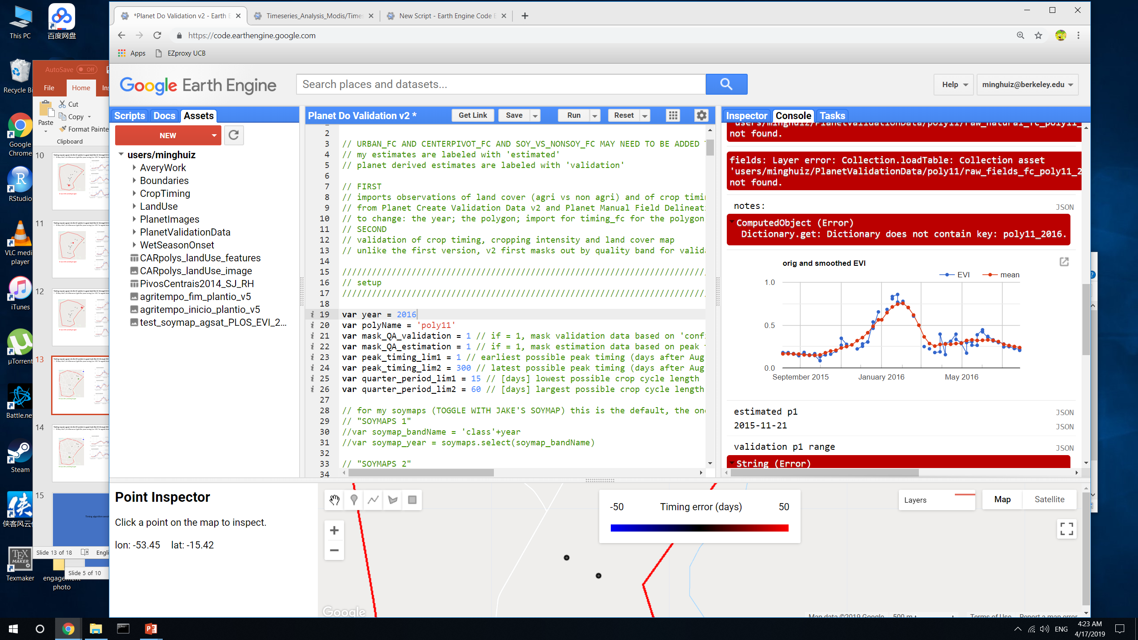
Testing soy pts agsat: do the DC points in agsat look like DC through EVI timeseries?
If they don’t, is it because I got the year wrong (i.e. 2017 in agsat doesn’t mean 2016 to 2017?)
DC soy in 2017, according to agsat
GEE file: Planet Do Validation v2

Slide 16
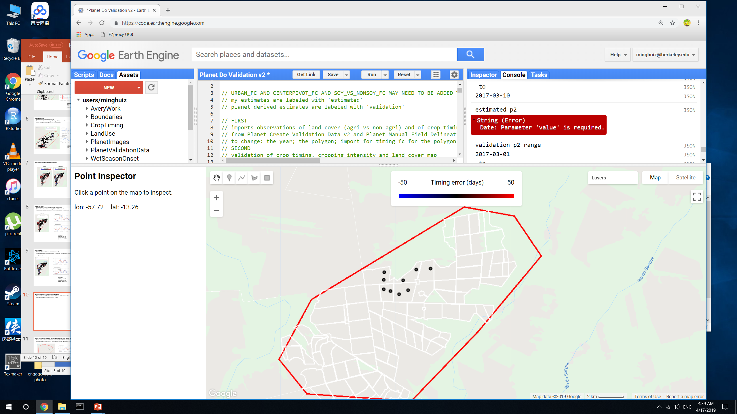
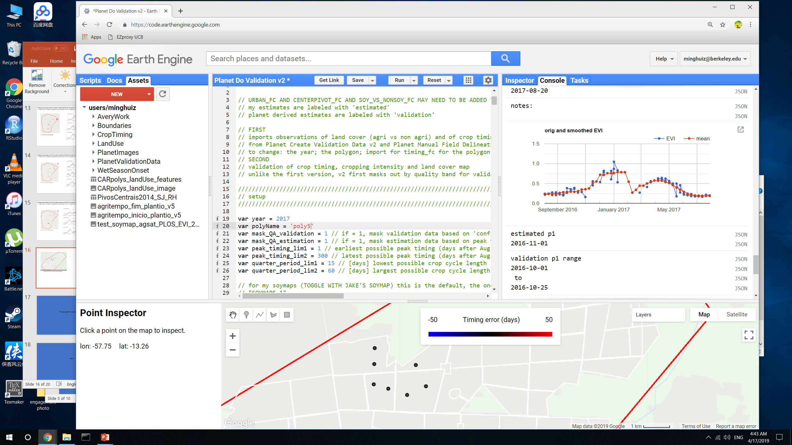
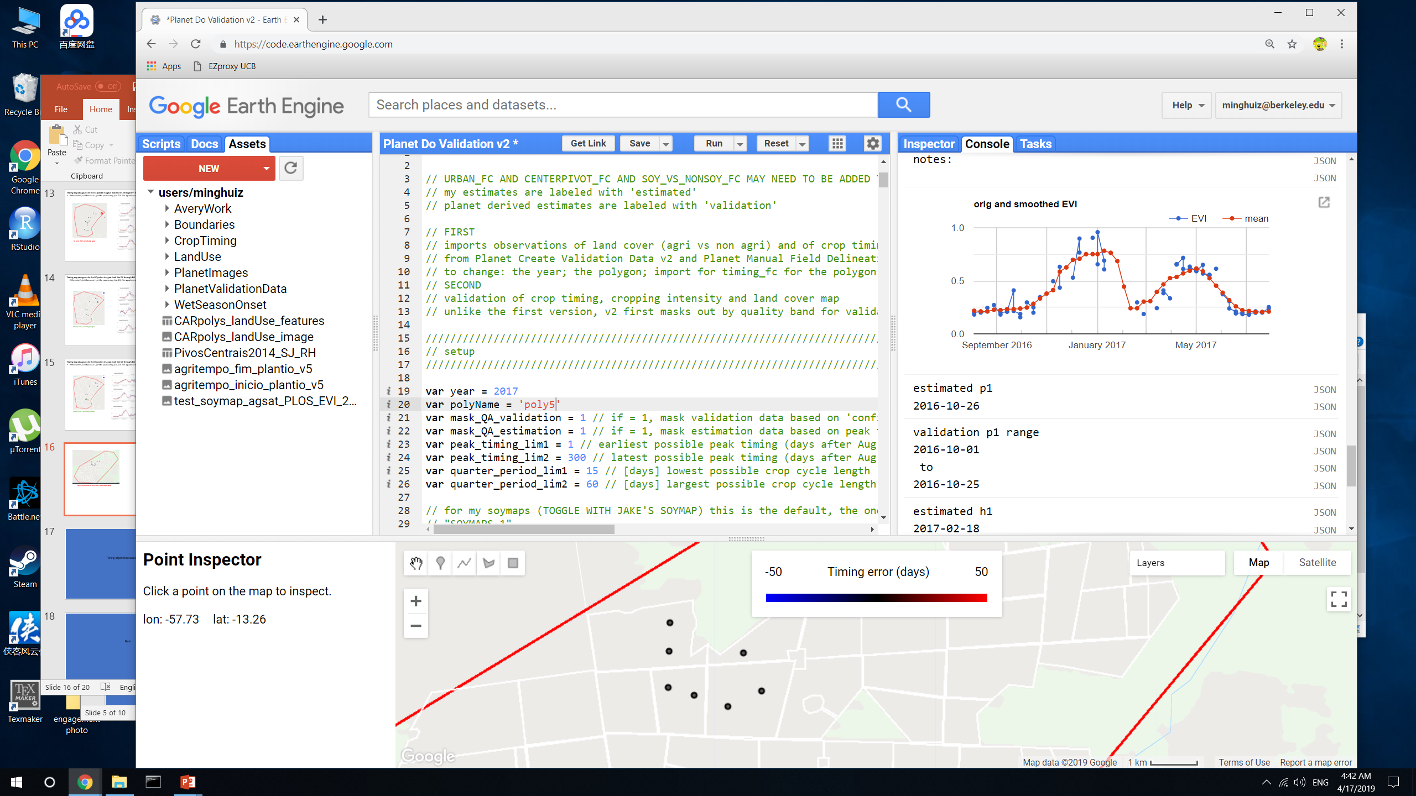
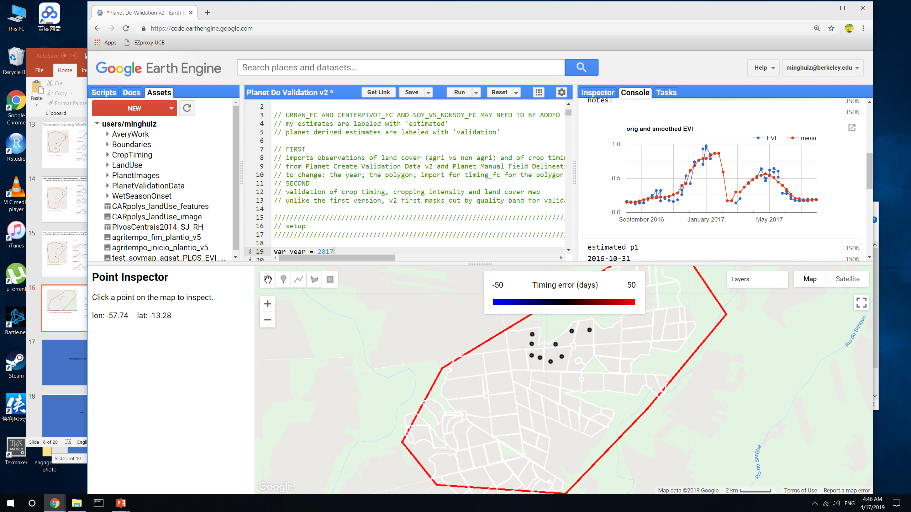
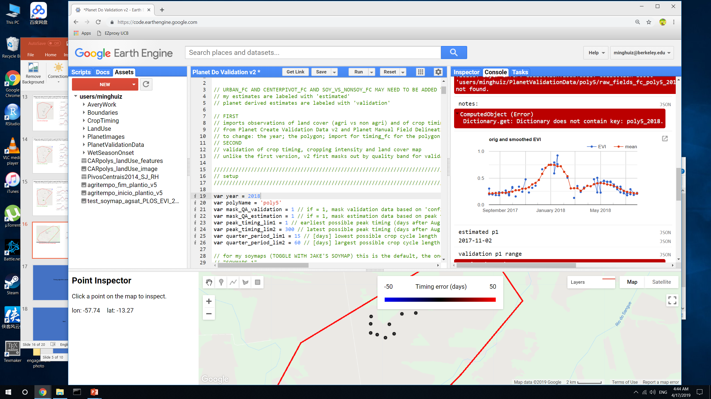
Testing soy pts agsat: do the SC points in agsat look like SC through EVI timeseries?
All these points are SC soy in 2017, according to agsat
GEE file: Planet Do Validation v2

Slide 17
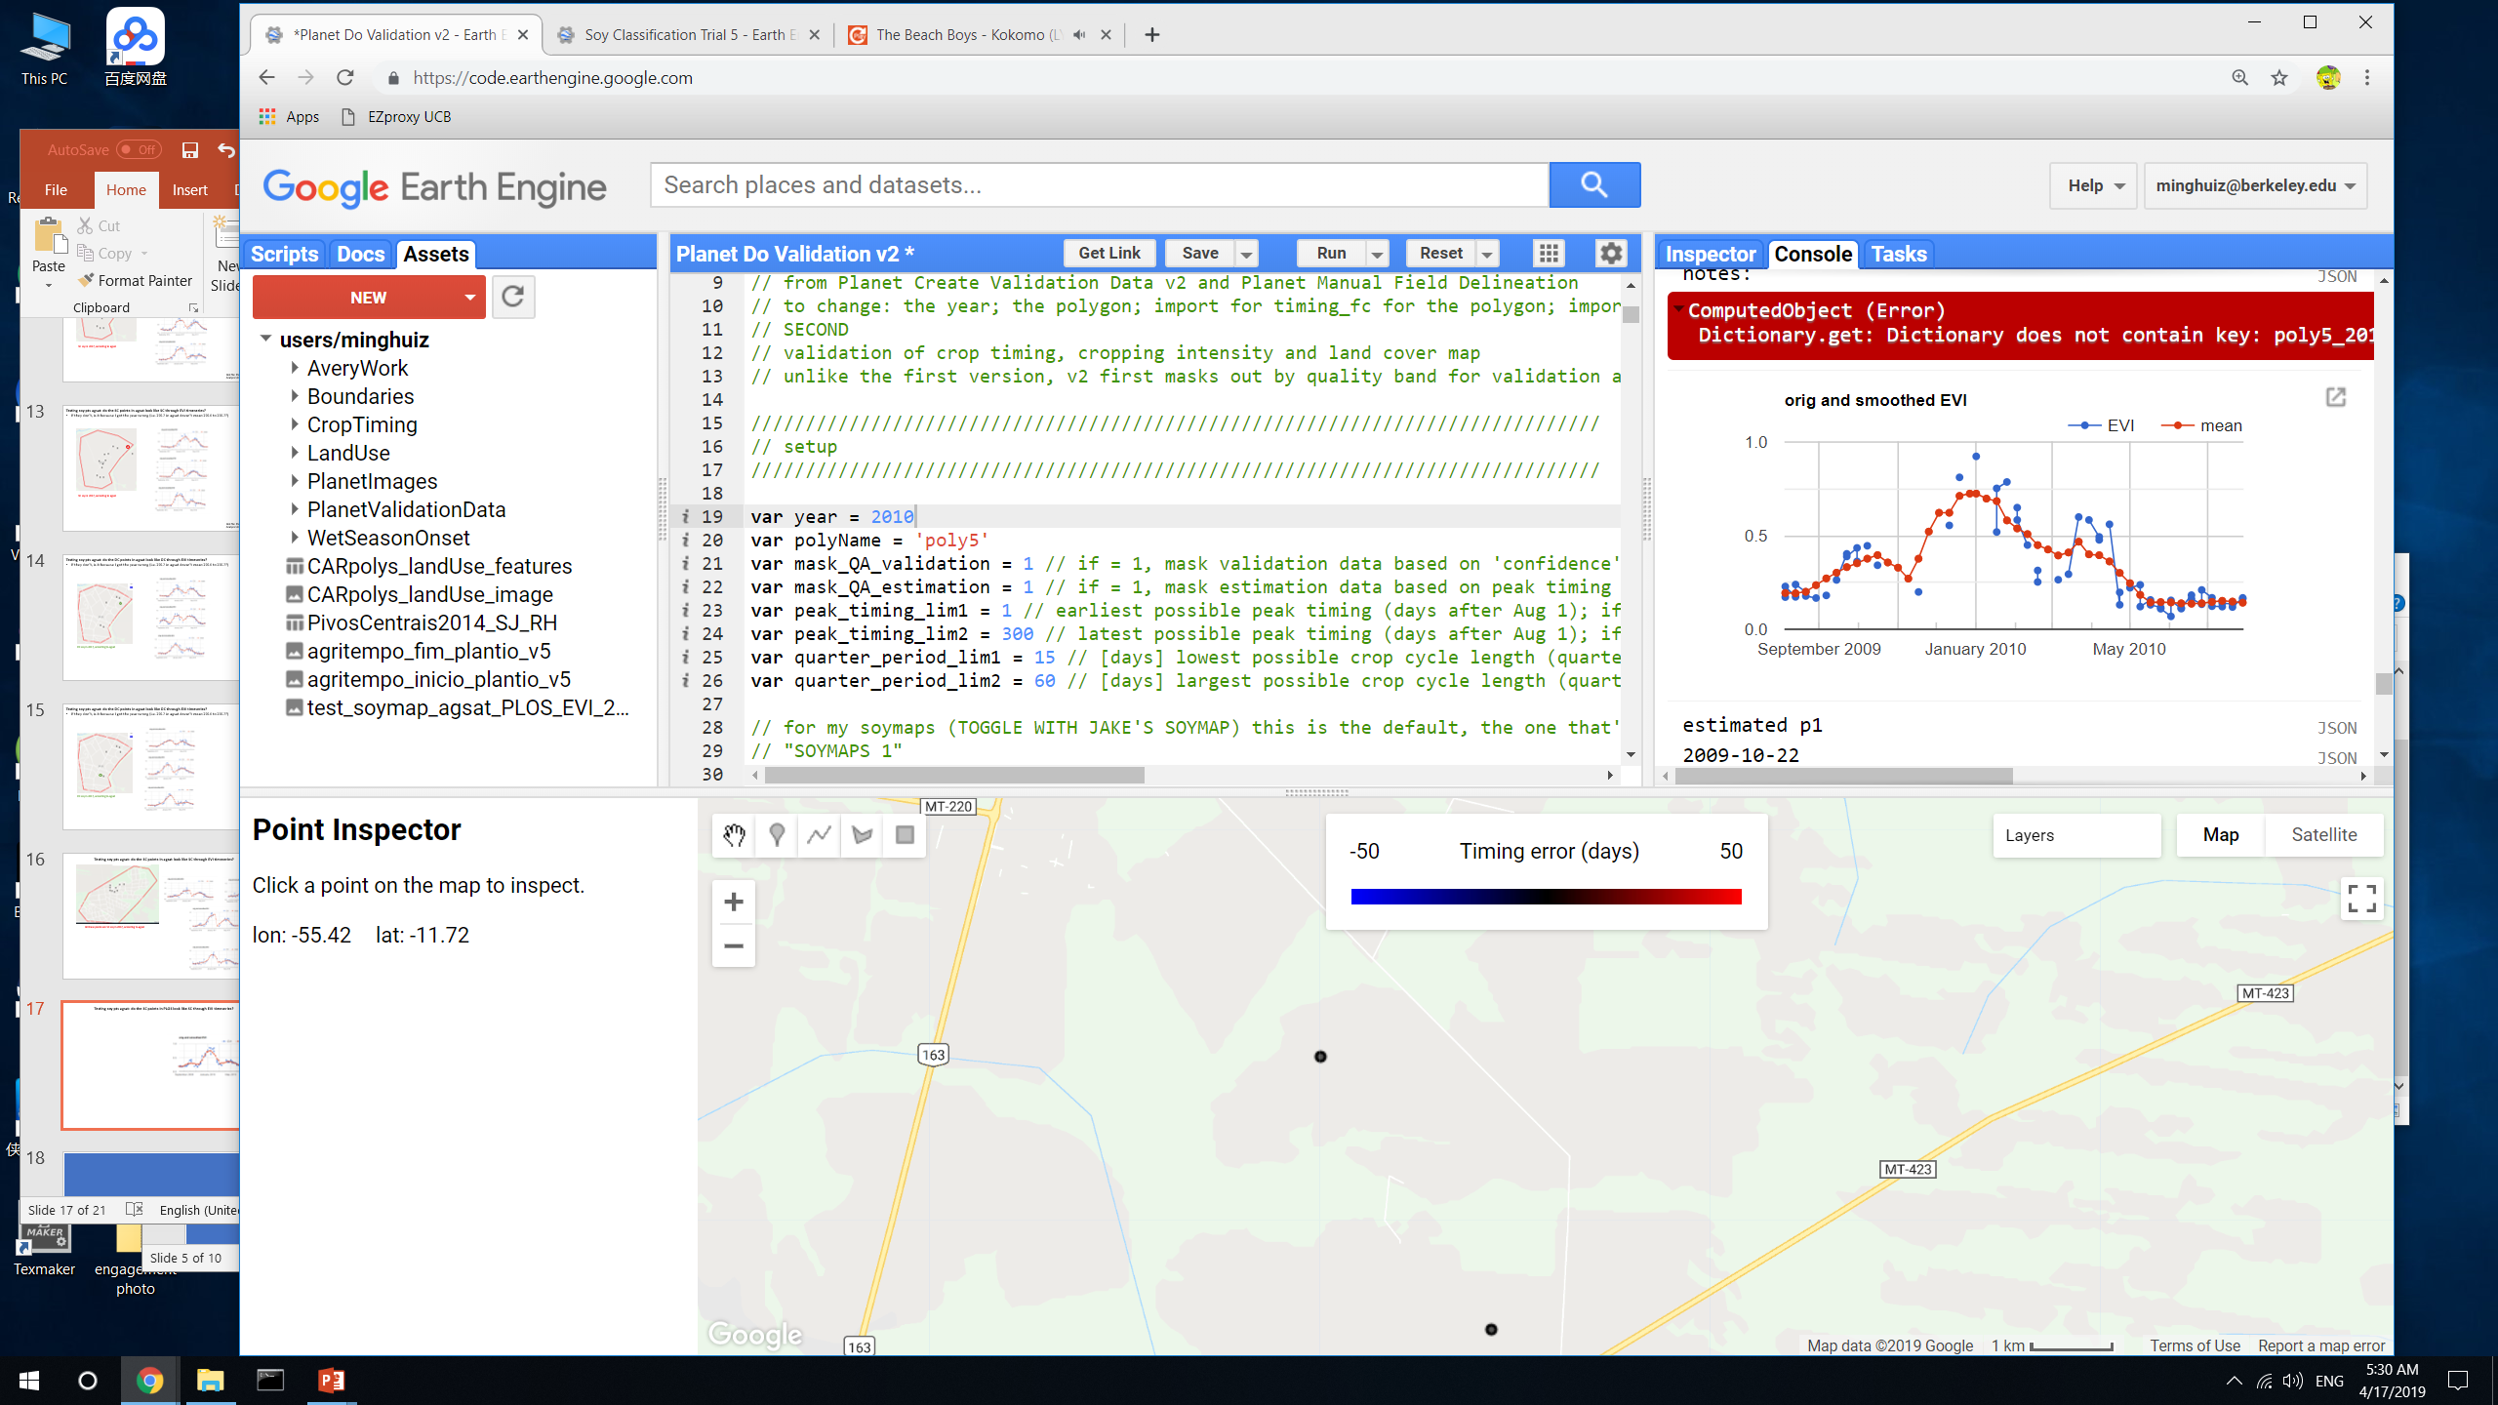
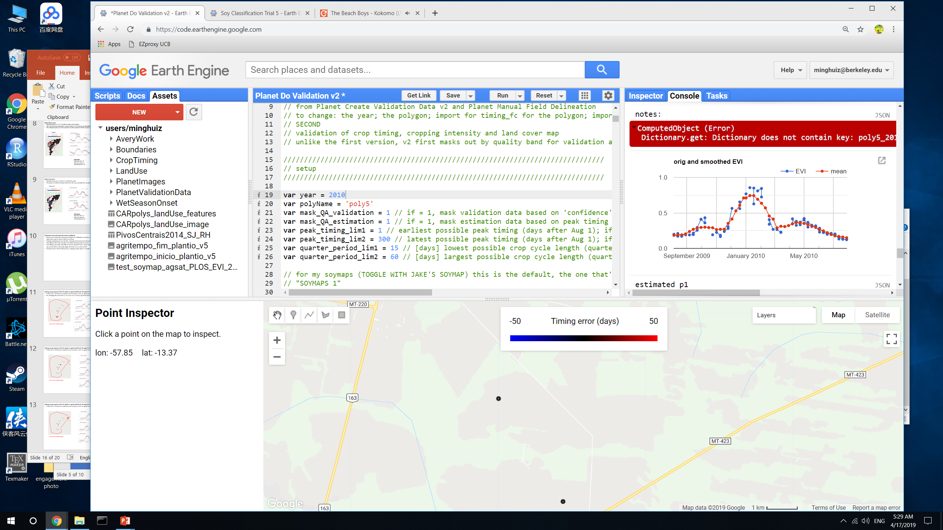
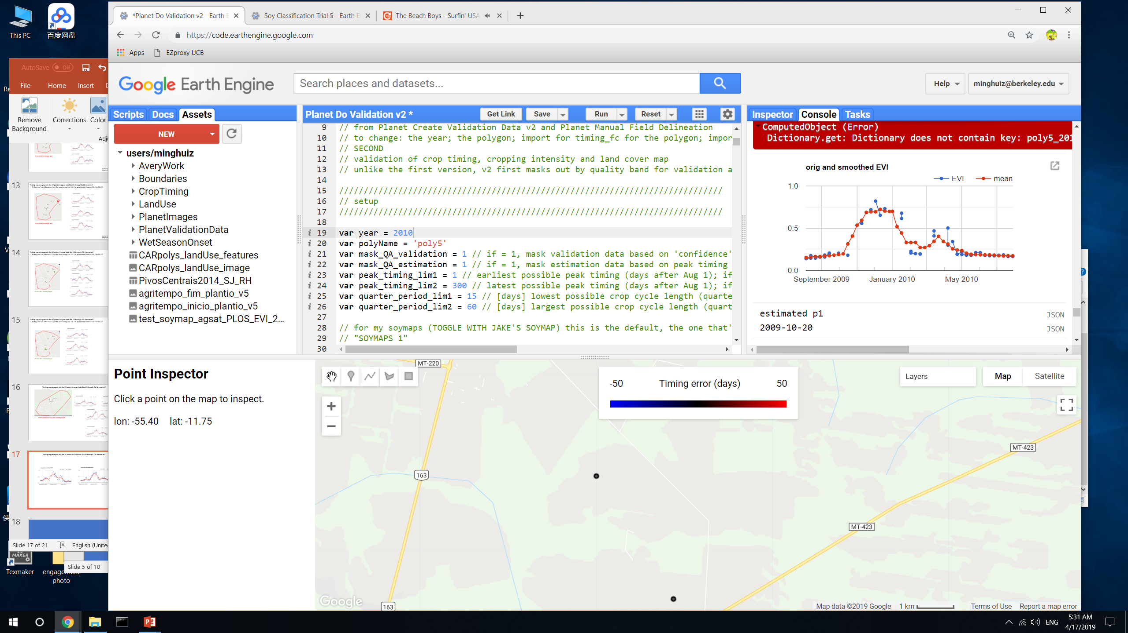

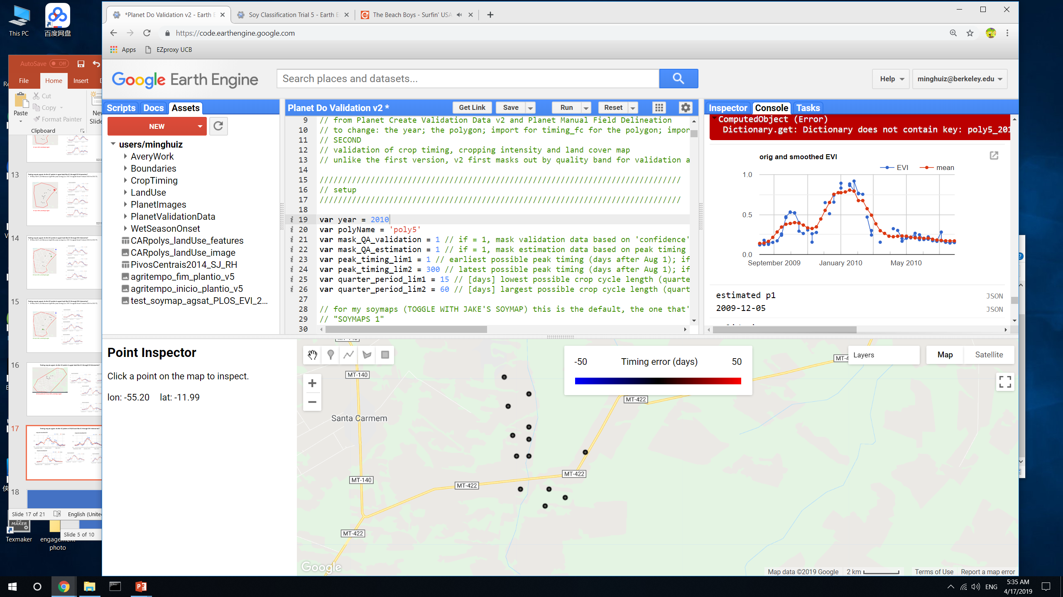
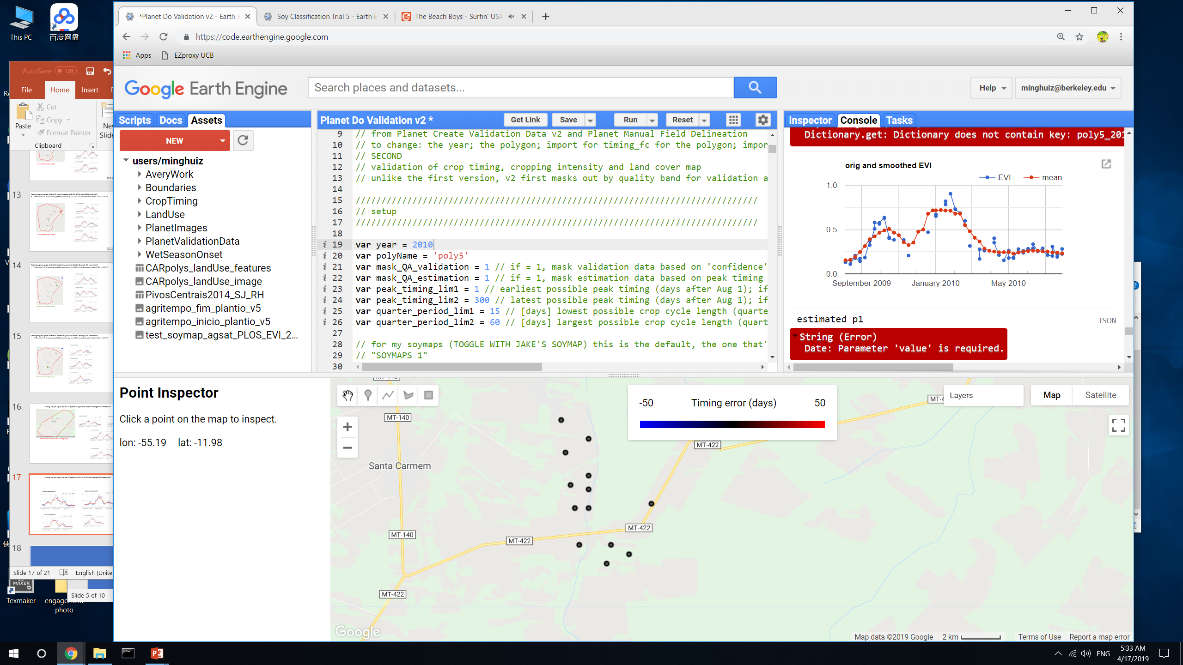
Testing PLOS: do the SC points in PLOS look like SC through EVI timeseries?
Takeaway
An SC pixel doesn’t necessarily have only one distinct peak. There may be a weed/starter crop at the beginning (small distinct peak) and natural vegetation that creeps in after harvest and declines very slowly.
GEE file: Planet Do Validation v2

Slide 18
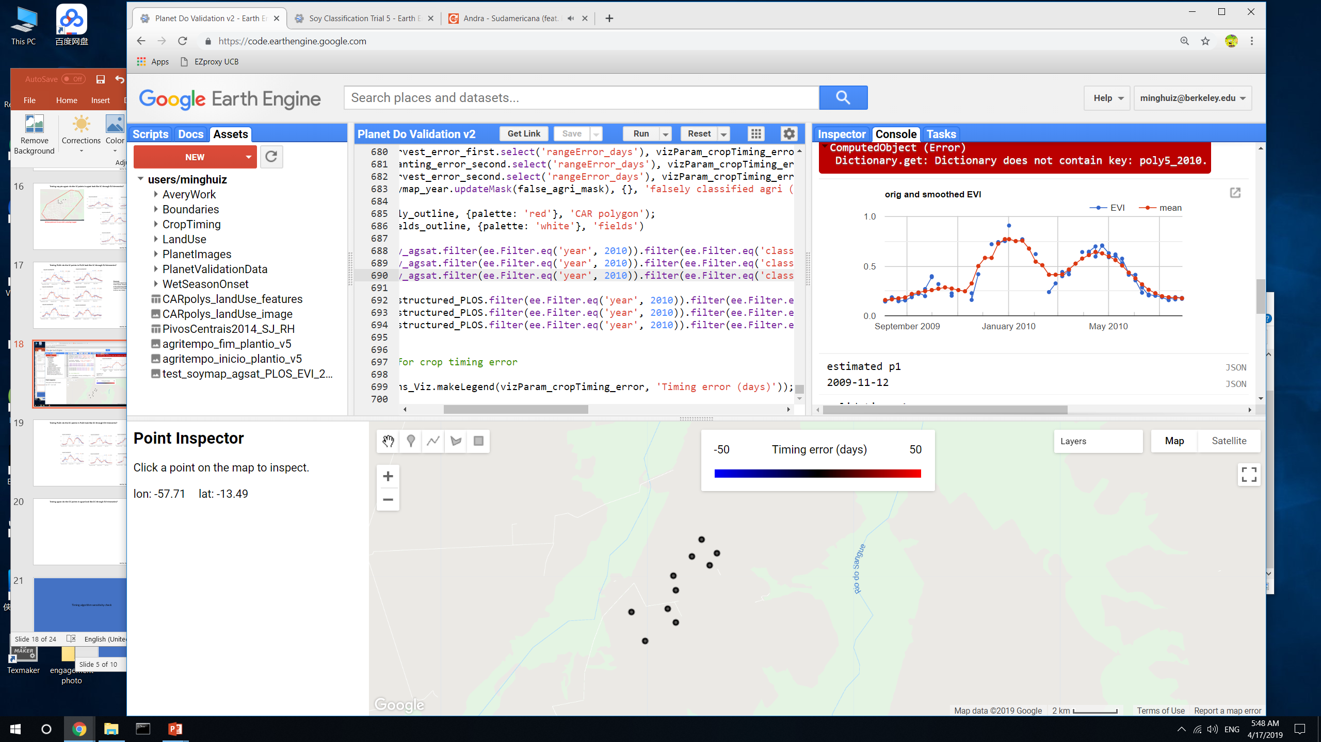
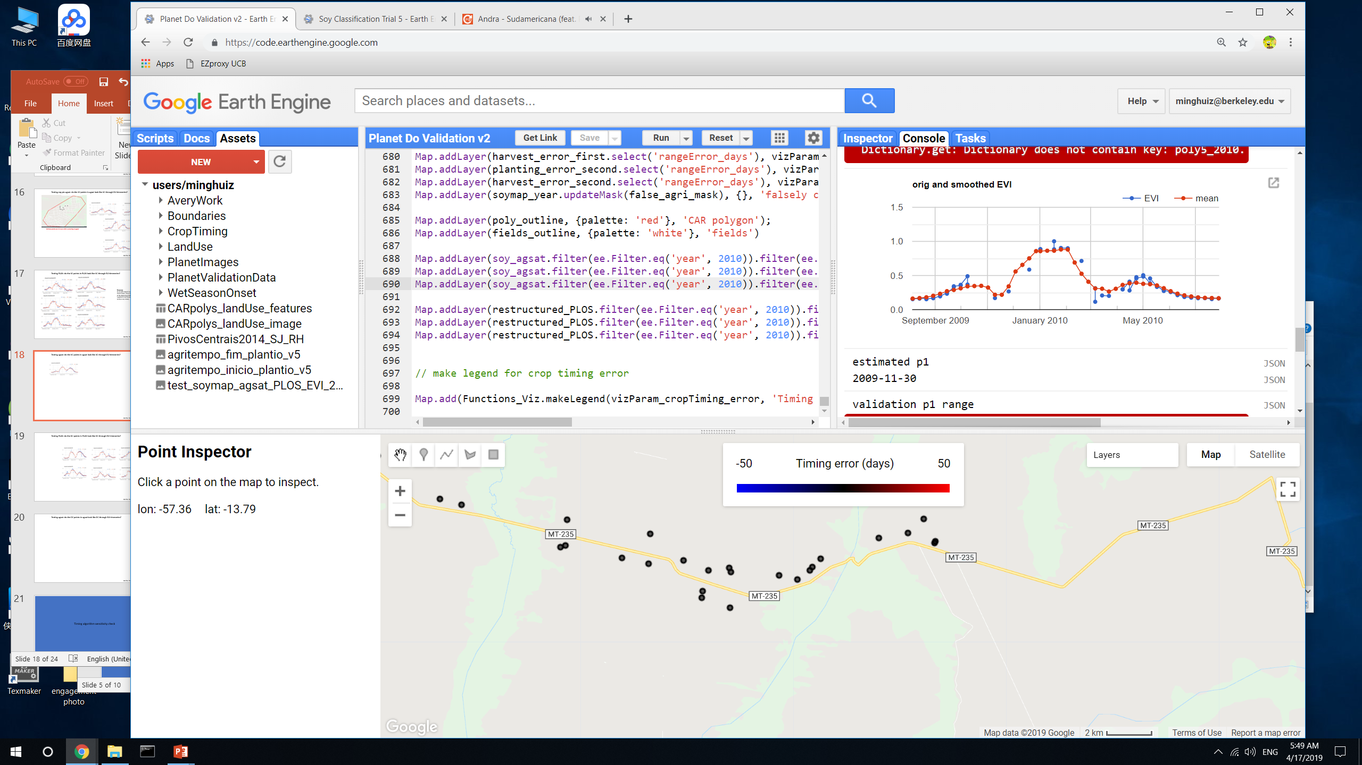
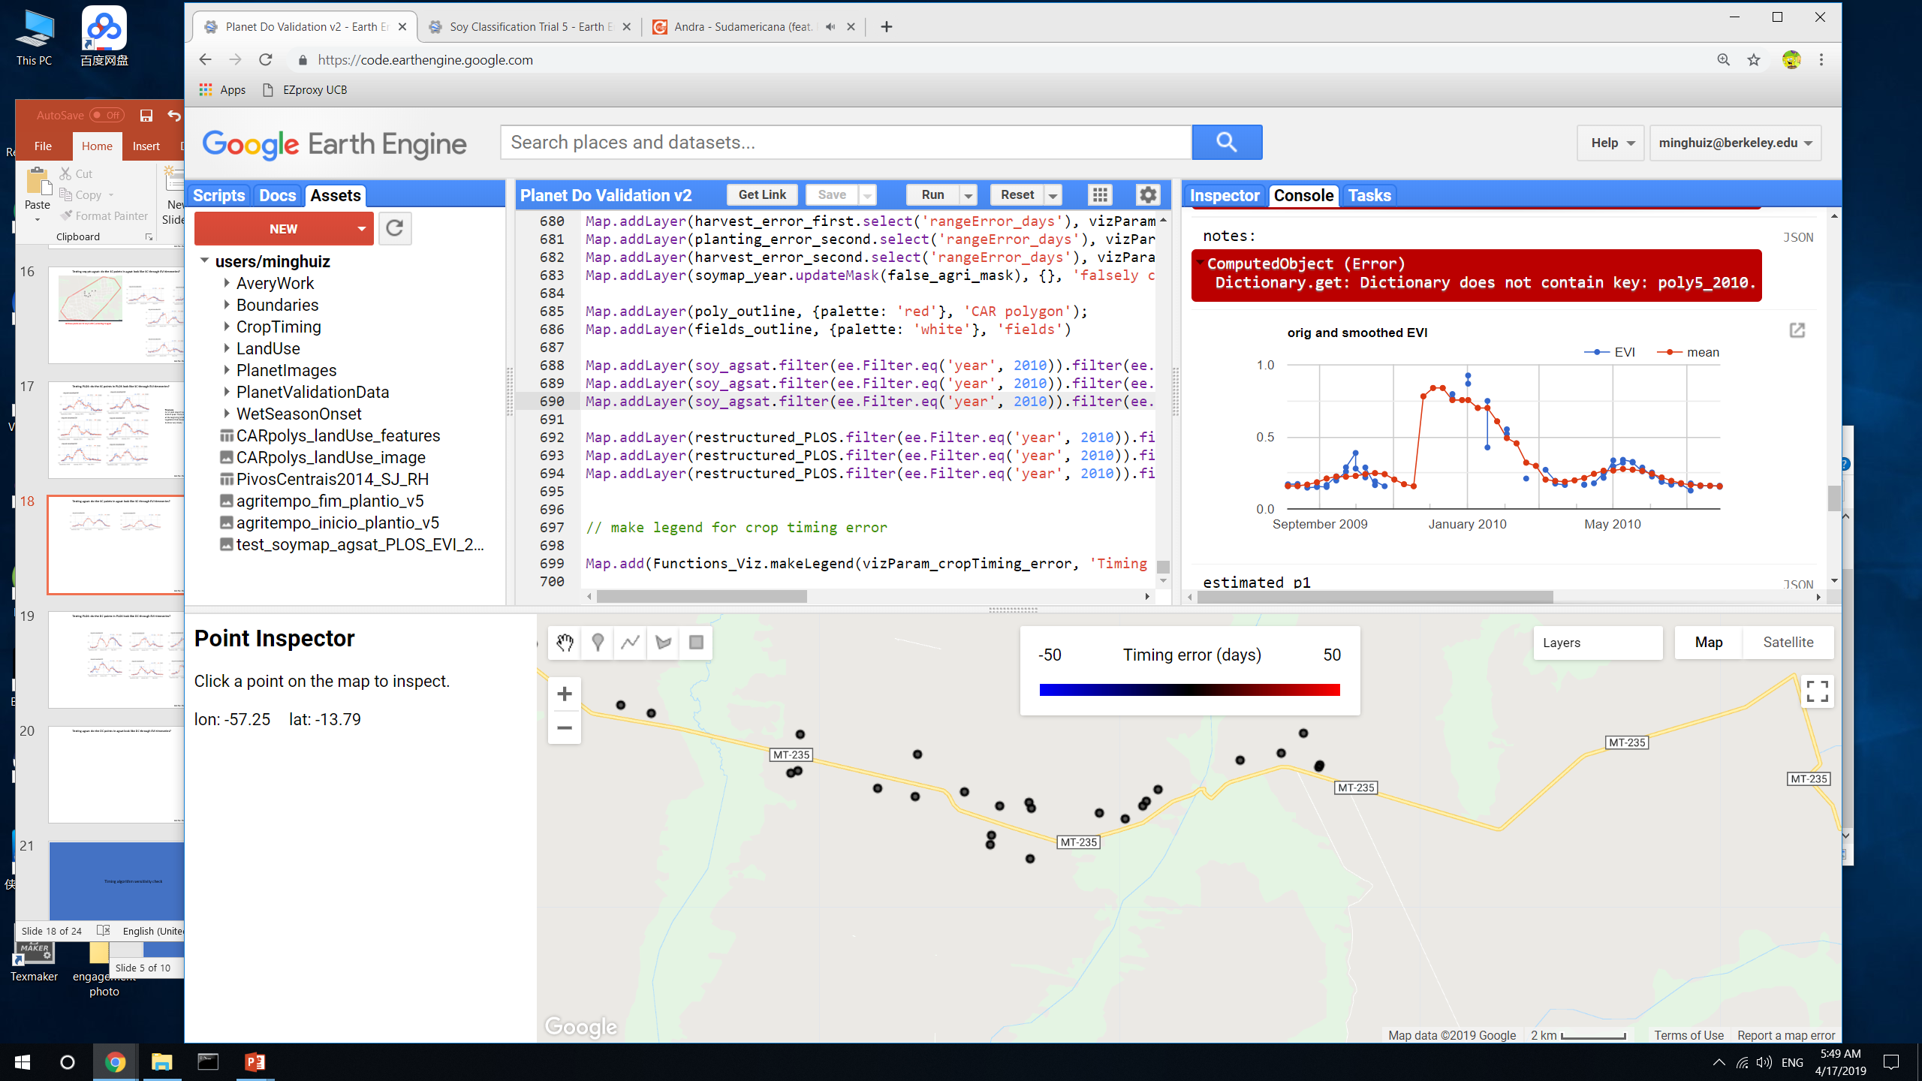
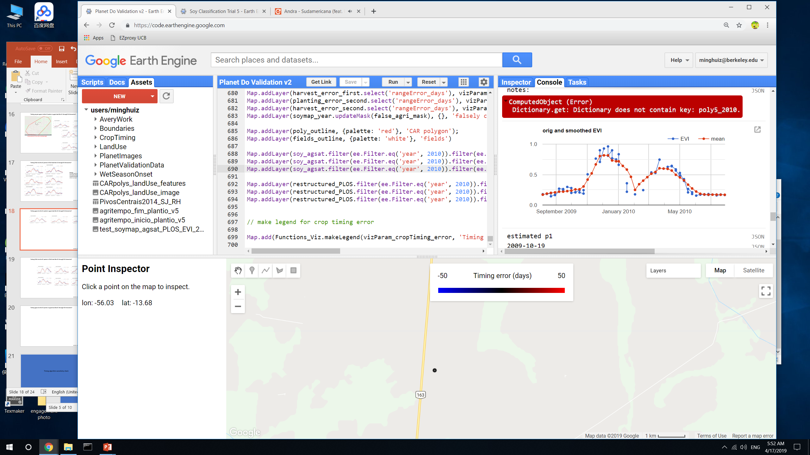
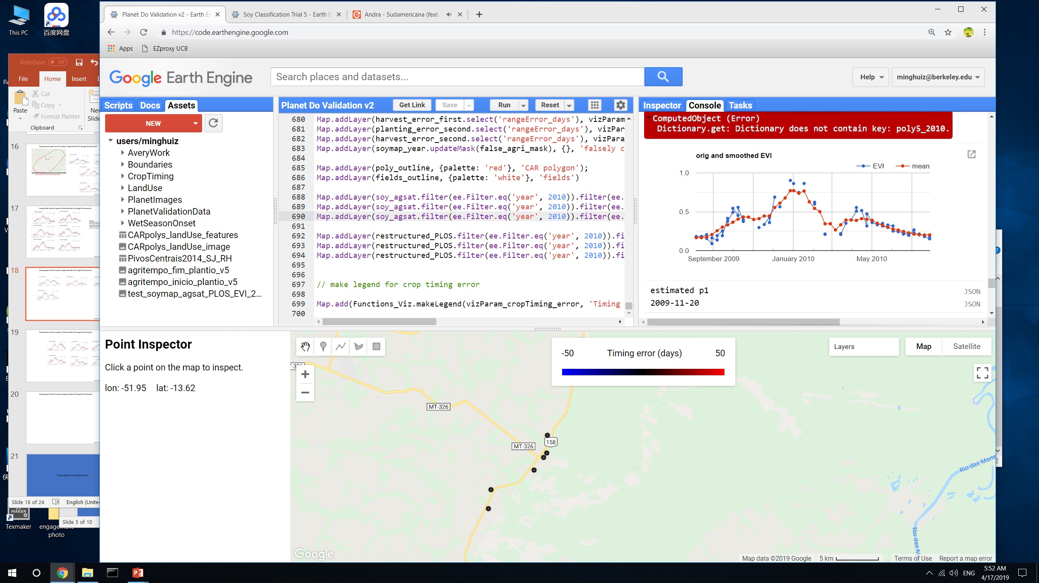

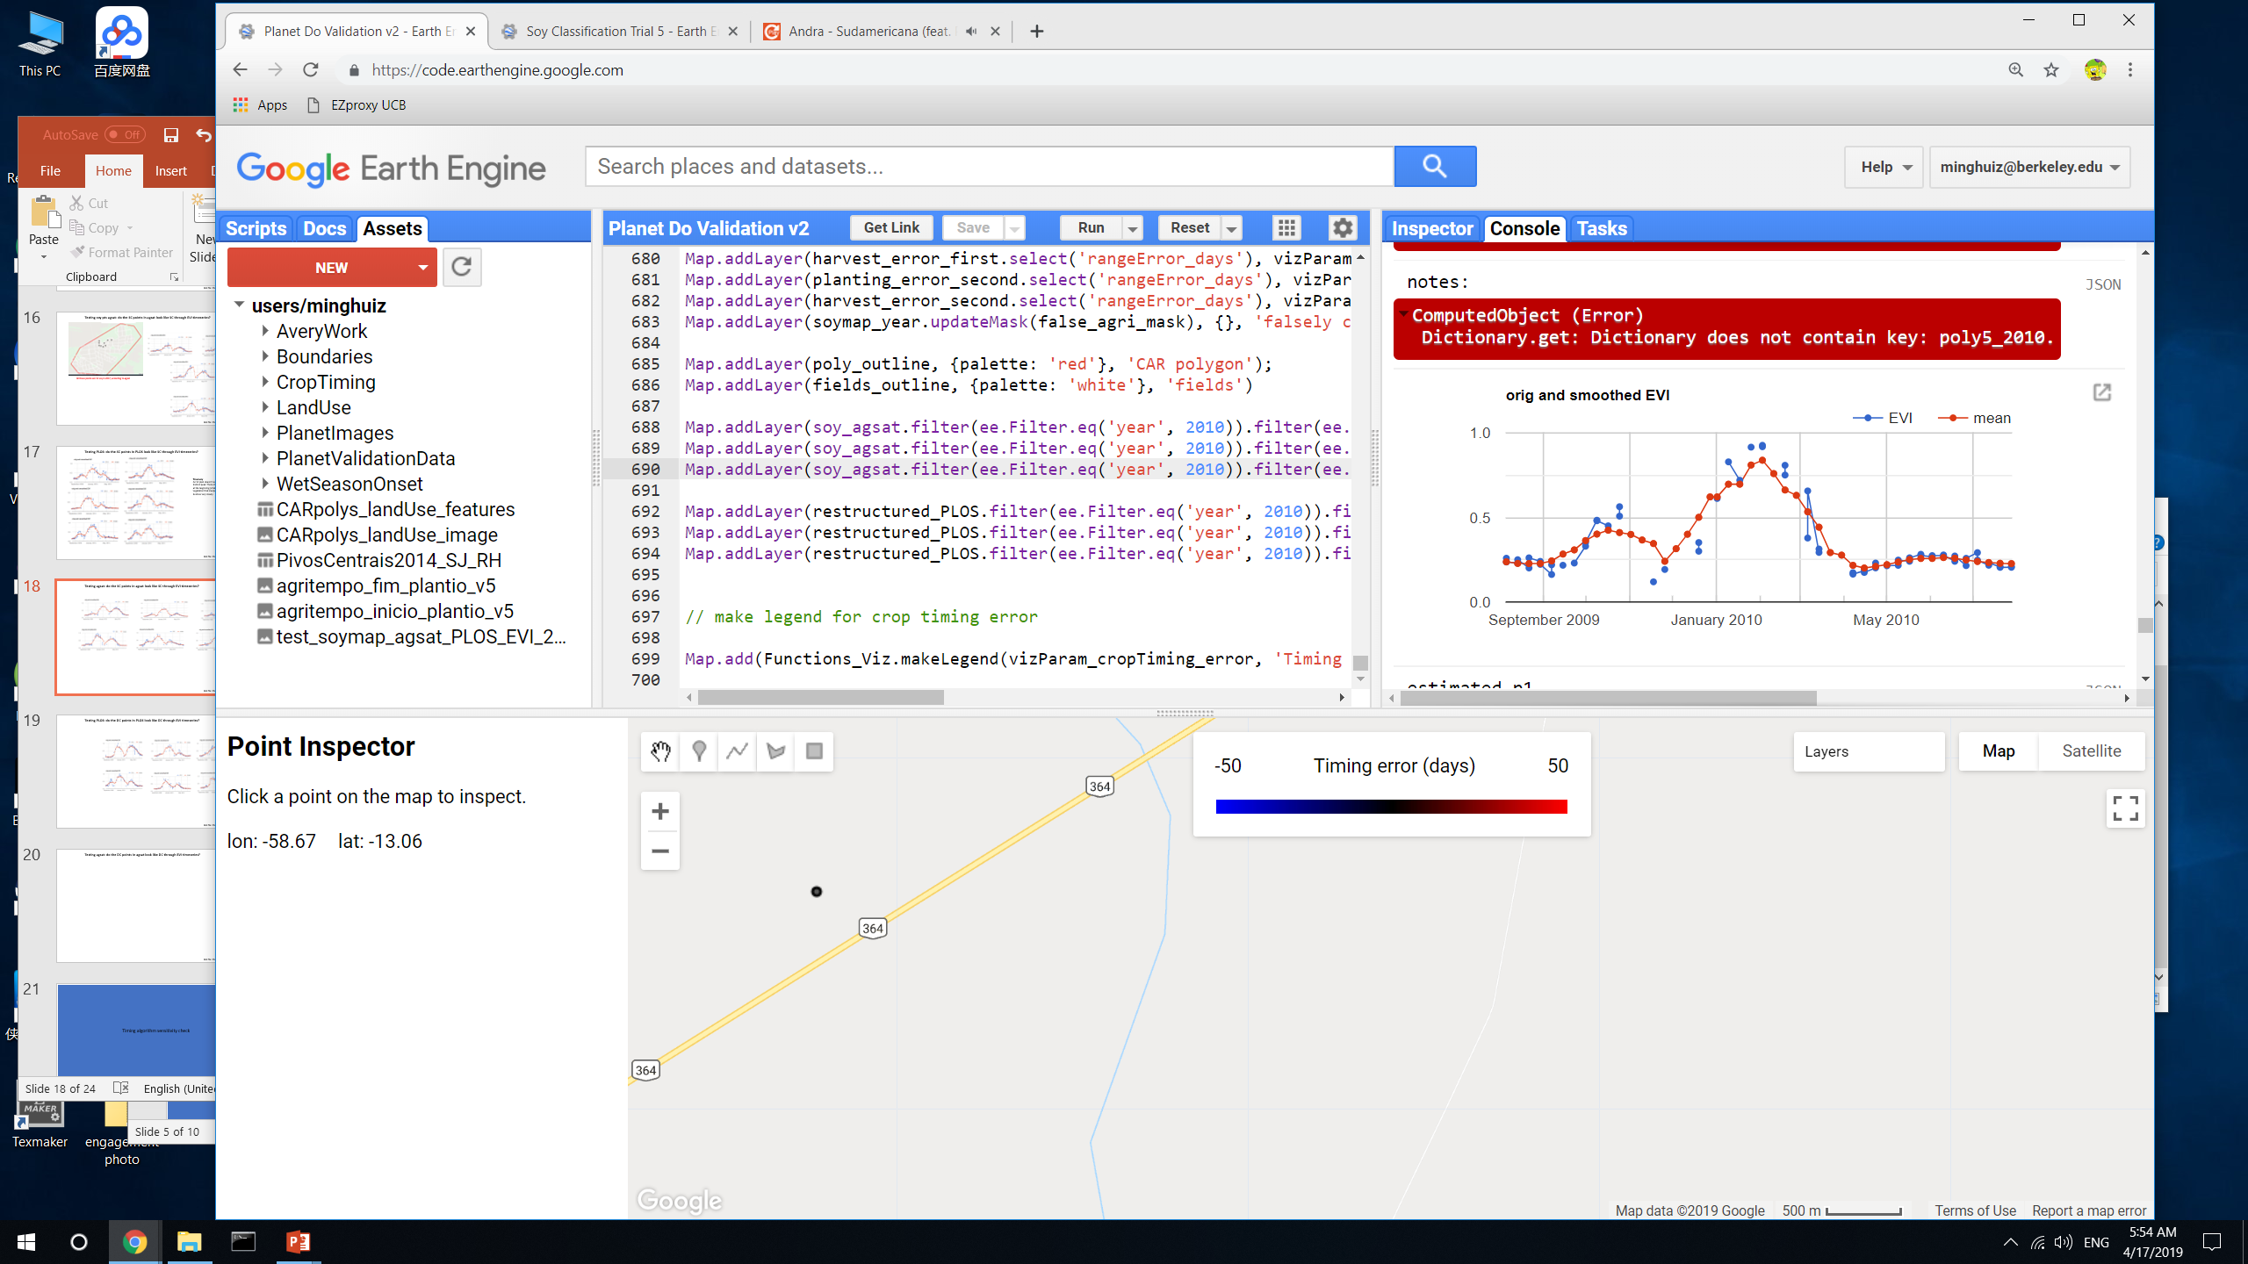
Testing agsat: do the SC points in agsat look like SC through EVI timeseries?
GEE file: Planet Do Validation v2

Slide 19
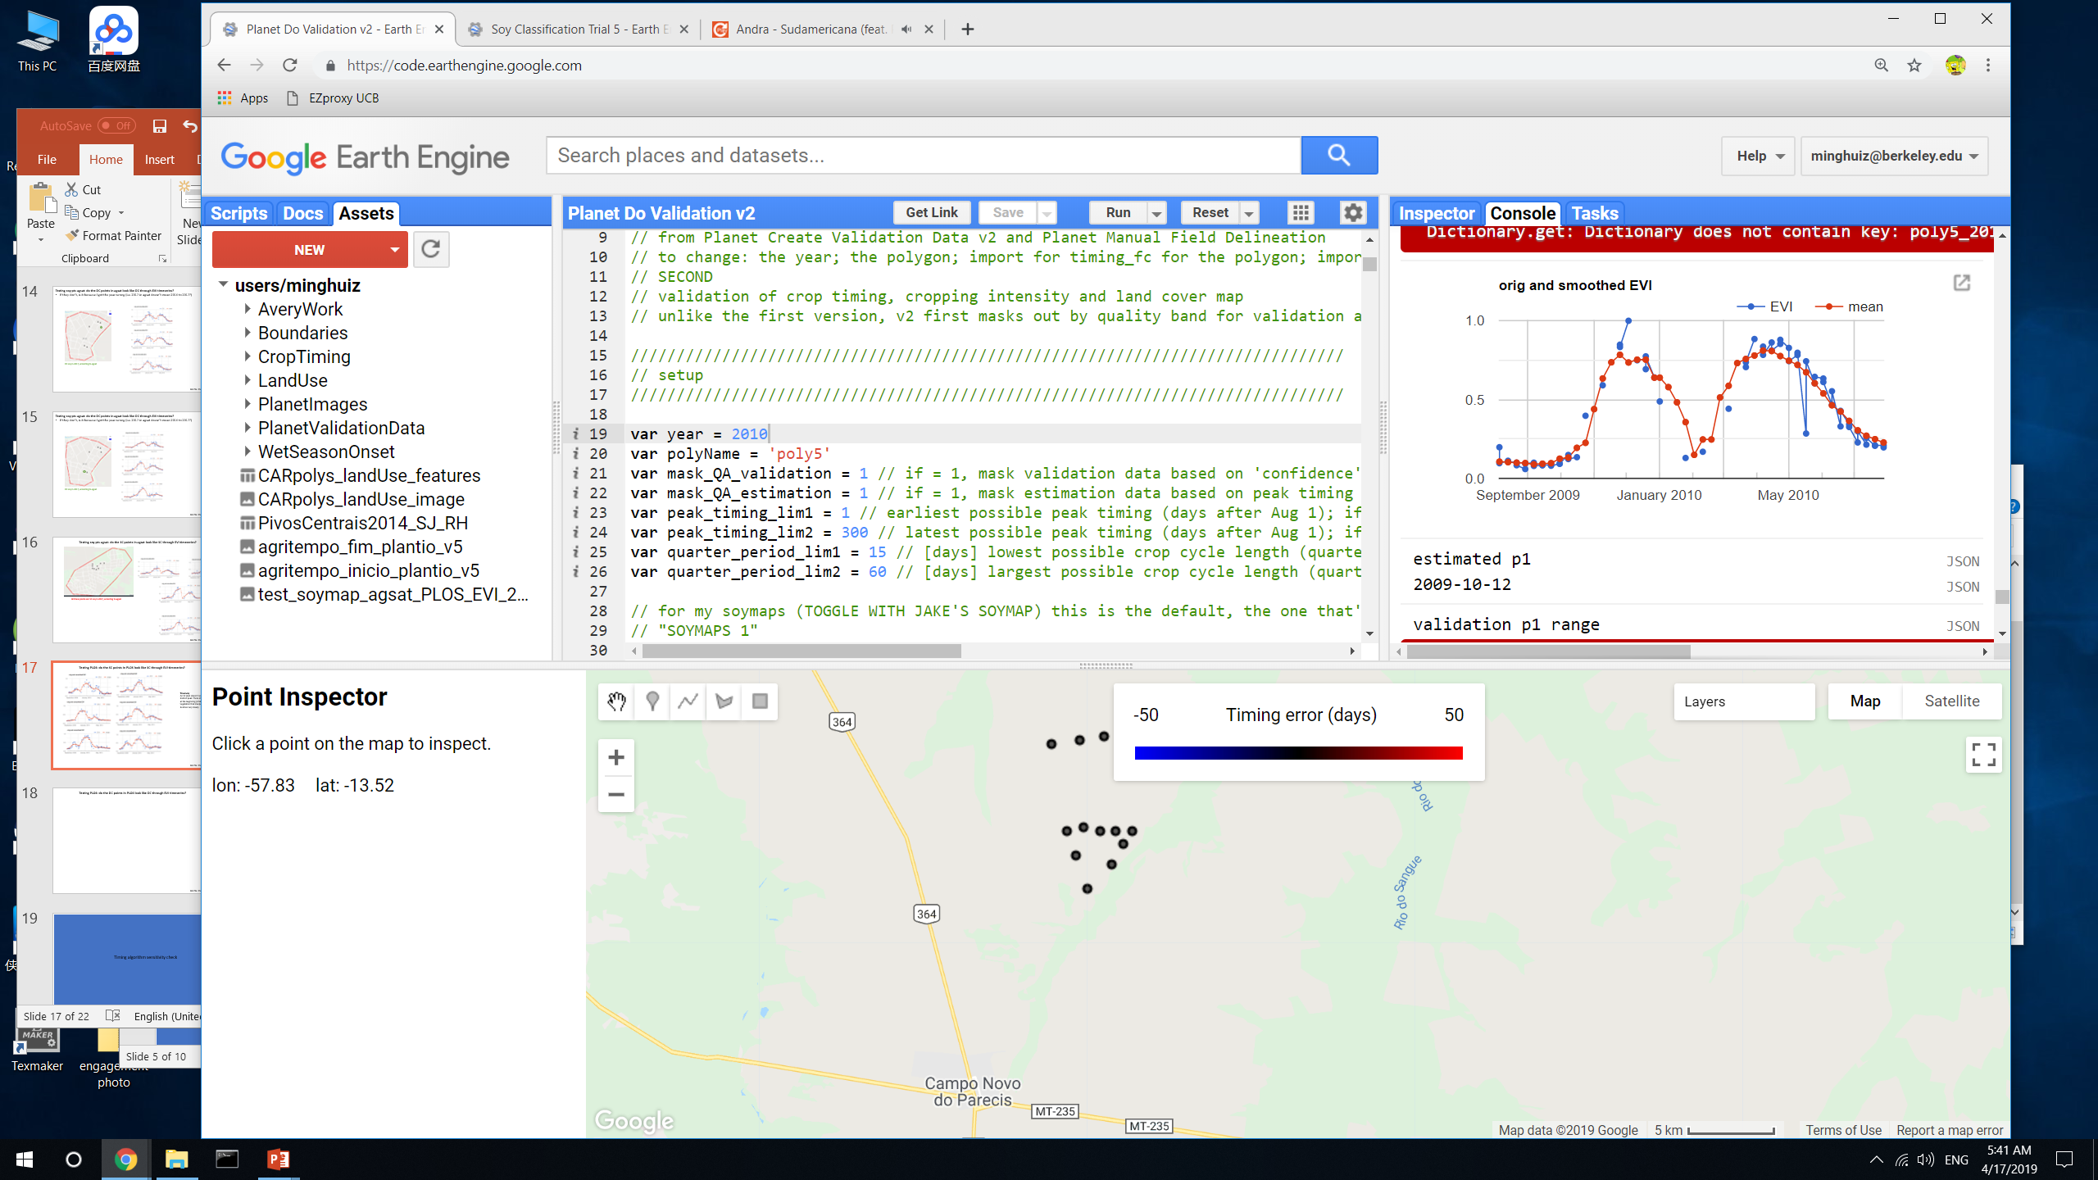





Testing PLOS: do the DC points in PLOS look like DC through EVI timeseries?
GEE file: Planet Do Validation v2

Slide 20






Testing agsat: do the DC points in agsat look like DC through EVI timeseries?
Takeaway
Maybe use PLOS alone to train data, since the timeseries of its SC and DC points look more consistently like SC and DC
GEE file: Planet Do Validation v2

Slide 21
More soymap trials

Slide 22
New soymaps
To start, these maps aren’t actually produced as assets – need to conserve asset storage space. Instead, export the accuracies wrt training points (agsat and PLOS) to see which are most accurate.
 | Soymap 5 | Soymap 10 | Soymap 12
GEE asset name | Base_soymap_agsat_reclassPLOS_EVI_(year) | Base_soymap_agsat_phenospectral3_(year) Soymaps_10 | Base_soymap_plos_phenospetral3_(year) Soymaps_12
Training points | Soy_pts_agsat_1 (MT only), masked with map3 agri PLUS reclassed PLOS pts (MT only) | Soy_pts_agsat_1 (MT only), masked with map3 agri | Reclassed PLOS points only (as in soymap 5), masked with map3 agri
Year pooling | 2004-2017 points are pooled and are applied to 2004 – 2018; 2003 doesn’t have data yet | 2004-2017 points are pooled and are applied to 2004 – 2018; 2003 doesn’t have data yet | 2004-2017 points are pooled and are applied to 2004 – 2018; 2003 doesn’t have data yet
Input data | MODIS aqua derived EVI from Dec to June Landsat SRTM | Phenology: fitted ampl; peak DOY; quarter pd; peak EVI MODIS aqua and terra EVI, masked for clouds and smoothed with moving window avg | Phenology: fitted ampl; peak DOY; quarter pd; peak EVI MODIS aqua and terra EVI, masked for clouds and smoothed with moving window avg
GEE file: LandCover/Soy Classification Trial 5 to 8, LandCover/Soy Classification Create Final Asset

Slide 23
Do more cross validation to get confidence intervals on soymaps
Cross validation: set different seeds, and report the accuracy for all years (lumped)
mean
Soymap | Accuracy | Cons (0) | Cons (1) | Cons (2) | Prod (0) | Prod (1) | Prod (2)
6 (EVI, Dec to June) | 80.7 | 0.57 | 0.84 | 0.48 | 0.31 | 0.93 | 0.37
7 (phenology) | 81.9 | 0.63 | 0.85 | 0.58 | 0.36 | 0.94 | 0.42
10 (phenospectral with CART classifier) | 82.15 | 0.62 | 0.86 | 0.59 | 0.38 | 0.93 | 0.45
11 (phenospectral with random forest classifier) | 81.9 | 0.67 | 0.84 | 0.68 | 0.27 | 0.96 | 0.35
12 (phenospectral using plos training pts) | 69 | 0.63 | 0.76 | 0.32 | 0.6 | 0.77 | 0.36
stdev
Soymap | Accuracy | Cons (0) | Cons (1) | Cons (2) | Prod (0) | Prod (1) | Prod (2)
6 (EVI, Dec to June) | 0.82 | 0.05 | 0.01 | 0.05 | 0.03 | 0.01 | 0.06
7 (phenology) | 1.0 | 0.05 | 0.01 | 0.04 | 0.06 | 0.01 | 0.03
10 (phenospectral with CART classifier) | 0.52 | 0.03 | 0.01 | 0.05 | 0.04 | 0.01 | 0.04
11 (phenospectral with random forest classifier) | 0.62 | 0.04 | 0.01 | 0.1 | 0.01 | 0.004 | 0.03
TAKEAWAY: soymap 10 is the best option, only use PLOS points to train

Slide 24
Timing algorithm sensitivity check

Slide 25

Sensitivity analysis parameters
 | Value (current version in bold) | Overall error, planting date | Overall error, harvest date | Error for location 1, planting date | Error for location 1, harvest date | Error for location 2, planting date | Error for location 2, harvest date
Peak cutoff date | March 1
 | March 15
 | April 1
 | April 15
 | April 30
Moving window size(s) for smoothing EVI | 10 days, 30 days
 | 20 days, 30 days
 | 30 days, 30 days
 | 20 days, 20 days
 | 20 days, 40 days
Moving window size for smoothing dEVI/dt | 20 days
 | 30 days
 | 40 days
 | 50 days
 | 60 days
Planting calibration equation | Peak -1 q.pd
 | Peak - 1.25 q.pd
 | Peak - 1.5 q.pd
 | Peak - 1.75 q.pd
 | Peak - 2 q.pd
Harvest calibration equation | Peak + 0.5 q.pd
 | Peak + 0.75 q.pd
 | Peak + 1 q.pd
 | Peak + 1.25 q.pd
 | Peak + 1.5 q.pd

Slide 26
Next

Slide 27
Crop timing
For natural vs agri accuracy, try masking edges and masking by crop cycle and peak EVI target only agri
Look at the dates corresponding to the low error fields and see if they represent the full range of crop dates represented by all the fields, because there might be a bias towards fields that were planted at a time when there weren’t clouds. This bias would also be solved if there are many locations of validation data.
Check QA/QC for the small peak before the larger peak (base threshold off places we know are DC and what the peak height is),
Robustness checking of timeseries analysis: how would plant, harvest results be different if (1) smooth EVI timeseries more or less; (2) smooth the 1st derivative more or less; (3) pick another cutoff date for first vs second peak? Choose the best combo based on Planet validation data; if no clear winner, report all versions.
Attach error distributions to crop timing estimates
At pixel and field/aggregated scale
Based on width of validation range and ‘range error’
Do all pixels/cells have the same error?
Separate errors for p1, (h1 + p2), and h2 (due to likelihood of clouds impacting TS analysis)
NEXT Planet image downloads:
For poly6 to 15 (based on soy_pts_agsat1), only download for 2016-2017. these are in MT – try to go for about 30 to 40 fields in different locations instead of 80 fields in a single location because of potential bias due to cloudy days
Colab: best way to use Python API with GEE (ipython notebook server)
Do pip install earthengine-api in colab to get virtual machine
Import ee
ee.Initialize()
ee.batch.Task.list() – proves can use earth engine
Docs: github/earthengine-api -> python -> examples -> ipynb -> example stuff

Slide 28
Planet imagery workflow
Uploading planet images as GEE asset
Properties of each image in PlanetLabs folder
Year, Month, Day, Satellite
PS_analytic_4band
RE_ortho_analytic
PS_ortho_analytic
PS_scene_analytic
Asset name is same as the description used in downloading from Planet web site
Lookup table in desktop has Planet order number and description and GEE asset name
Step | To do | Script/web site
1 | Find locations, years where Planet images are needed. Keep info on shp name, image name(s), and dates downloaded in Image_Lookup file in Google Drive | GEE: LandCover/Planet Image Selection
2 | Download cloud free, high temporal resolution Planet images (may need to pare down on locations, years) | Planet web site. Keep downloaded images in desktop
3 | Upload images as GEE assets | In desktop, keep tabs on asset id, polygon name, etc.
4 | Delineate individual fields, natural veg, agri, urban (houses) and center pivot in Planet imagery, and export as asset into the folder Planet Validation Data. The difference between fields and agri is that the fields contain individual (usu square) fields for timing observation purposes, whereas the agri contains lumped agri for land classification (natural vs agri) purposes. Assets are exported as ‘raw_agri_fc_poly1_year’, etc. need to turn delineated geometries into feature collections in order to export. | GEE: LandCover/Planet manual Field Delineation or Planet OBIA
5 | First import the Planet images and make custom visualizations for each, and map each with its own custom vis. Step through fields in CAR poly and record observed crop timing, export observations as feature collection to asset. Assets are exported as ‘timing_obs_for_polyName_in_year_part#’. Make sure to change the ‘part#’ BEFORE entering obs! 0 for SC, 1 for DC, 3 for TC or DC + failed first crop (2 is other agri in Jake’s classification) Remember to save the custom visualizations for the images in that polygon in Common Assets script | GEE: Planet Create Validation Data v3
5.5 | (for poly1, poly3, and poly5), go back to the timing validation data exported from Planet Create Validation Data v2 and add ‘confidence level’ for my crop timing and crop intensity validation dataset; use MODIS TS to help replace previous crop intensity classification. For confidence labels, use -1 for no data (i.e. no second crop); 0 for no confidence; 1 for confident | GEE: Planet Add QA for Validation Data
6 | Import timing and land cover feature collections. May need to combine timing feature collections into a single fc. Turn feature collection of observations into validation image (might need to first merge multiple obs fcs into a single one), use to do validation. The following are turned into dictionaries of images (or simply images): the observed plant/harvest times; the observed cropping intensity; the observed land cover (agri - 10, center pivot - 20, natural - 30, urban – 40). Use images to do validation of timing and land cover maps. | GEE: Planet Do Validation

